Slide 1
Enrollment Services Sustainability & Climate Action Plan
Composed and Presented
By PACES
2018

Slide 2
Overview
This presentation illustrates the findings from the assessment the PACES (Program for the Assessment and Certification for the Environment and Sustainability) Program completed and includes recommendations for future action.

Slide 3
Transportation
Areas of Leadership
52% of employees that attend conferences opt for the option to use video call to reduce long distance travelling.
60% of the department is knowledgeable about TAP (Transportation Alternatives Program)

Slide 4
Transportation
Areas of Improvement
Increase the number of employees that opt for alternative transportation
Bike
Bus
Carpool
Goleta Commuter Rail*
Engage faculty in events like CycleMAYnia

Slide 5
Transportation
Areas of Leadership
Registering a team for CycleMAYnia
Visit www.cyclemaynia.ning.com
Register and request membership
Up to 8 team members
Notes:
CycleMAYnia is coming up – annual bike challenge that encourages employees to bike to work rather than use a single-occupancy vehicle
‹#›
Incentives for participating in the program will be available and are to be determined

Slide 7
Energy Areas of Leadership
More than 75% of occupants use energy saving features
Stand-by mode or hibernate when not at the computer
Low brightness level on computer
Avoid screensavers

Slide 8
Energy Areas of Improvement
48% of employees do not unplug their devices when not in use.
Use a power strip to easily unplug devices
Unplug devices at the end of the work day
Unplug centralized devices at the end of the work week

Slide 9
Energy Areas of Improvement
Eliminate personal heaters and fans
Temperature comfort has a significant impact on employee productivity and satisfaction. Improperly working heating and cooling systems are also often energy hogs.
Regularly communicate temperature needs to Building Operations and/or Facilities
If the building is not performing adequately, use Energy Star rated fans and heaters.

Slide 10
Energy Areas of Improvement
Reduce the amount of energy consumed from lighting
Add reminder signs/signage for rooms without automatic light controls
Use a task lamp (preferably LED lighting)

Slide 11
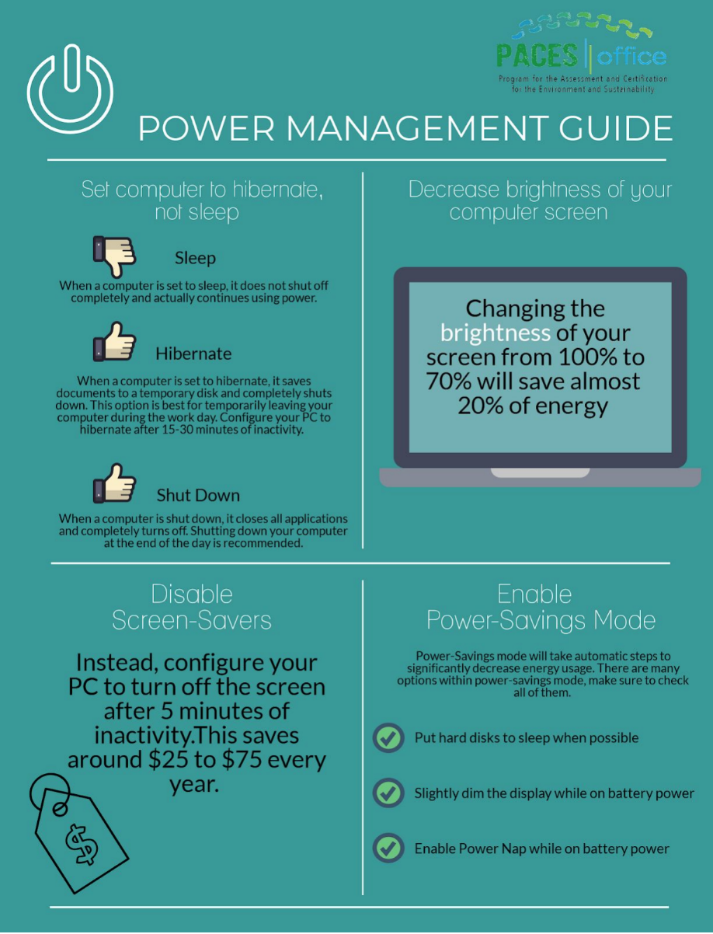
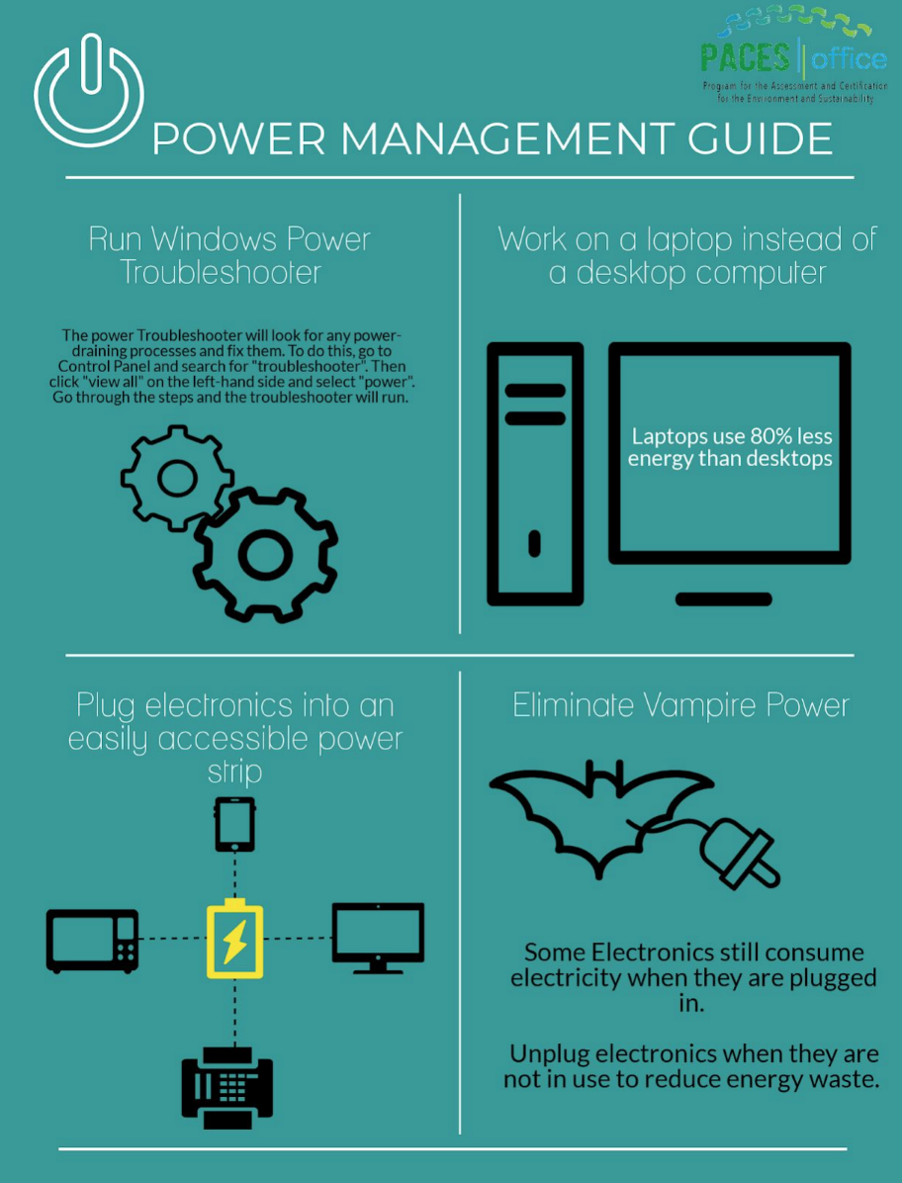

Slide 12
Material and Resources Areas of Leadership
Purchases are completed electronically through Gateway
Use of 100% post-consumer recycled paper for some processes
Use of whiteboards to reduce paper consumption

Slide 13
Material and Resources Areas of Improvement
Purchase appliances and office supplies with reliable certifications
Purchase items in bulk to prevent multiple trips
Purchase reusable items and eliminate disposal products
Reusable rags and towels
Mugs and bottles
Dishware

Slide 14
Reliable Certifications

Slide 15
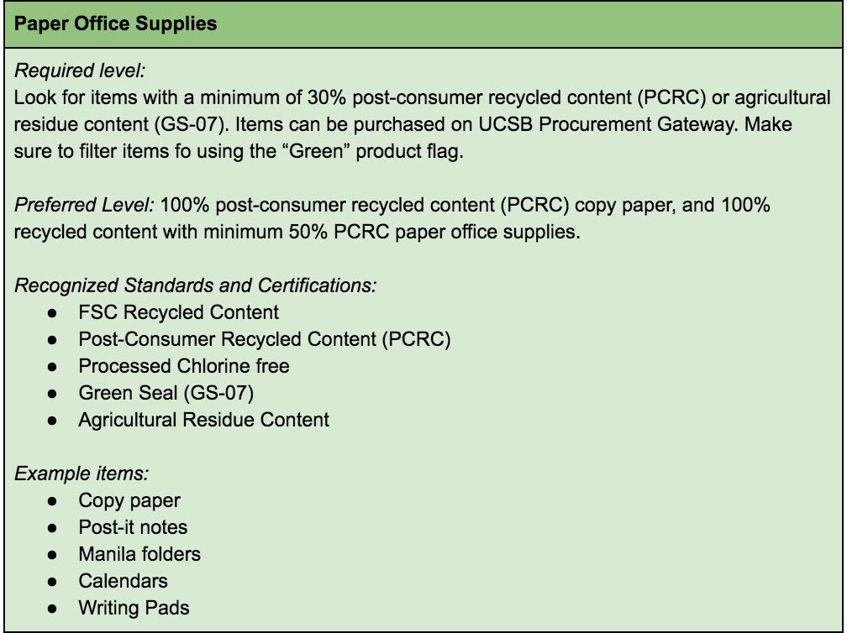
Sustainable Purchasing Guide

Slide 16
Solid Waste Management Areas of Leadership
80% of occupants use reusable mugs and bottles
60% use occupants use reusable dishes
Recycling bins present in more than 90% of office spaces
Use of scratch paper and double-sided setting for print jobs

Slide 17
Solid Waste Management Areas of Improvement
Monitor the number of prints
Pair all trash and recycling bins
Sort waste properly by increasing signage
Introduce new solid waste management programs
Stationary recycling (Terracycle)
Composting

Slide 18
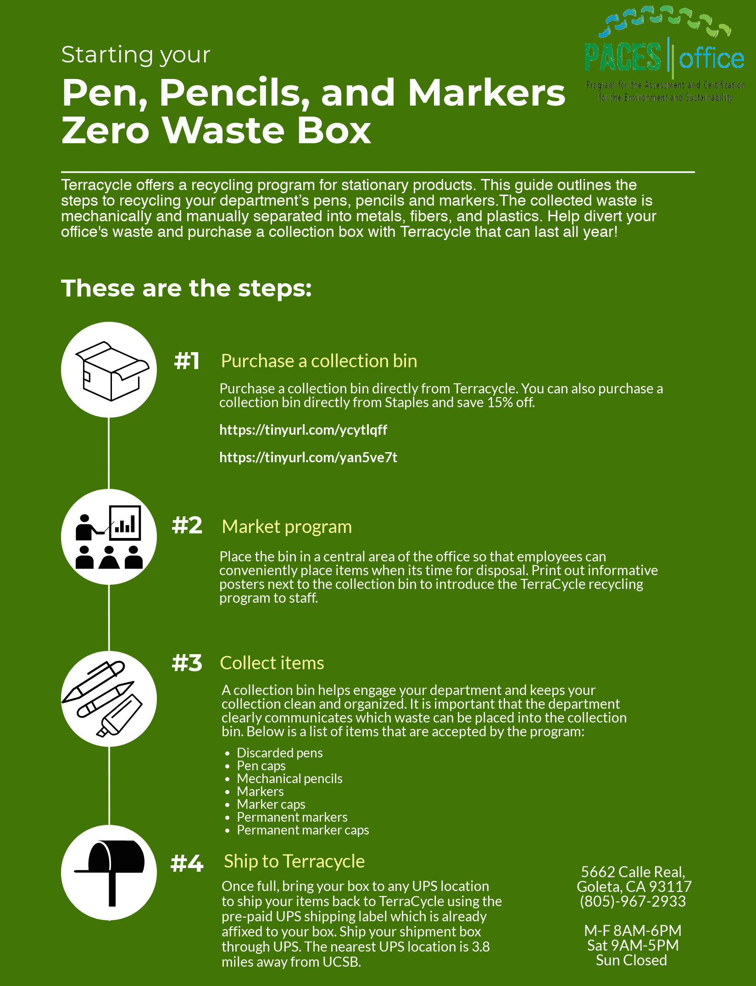

Slide 19
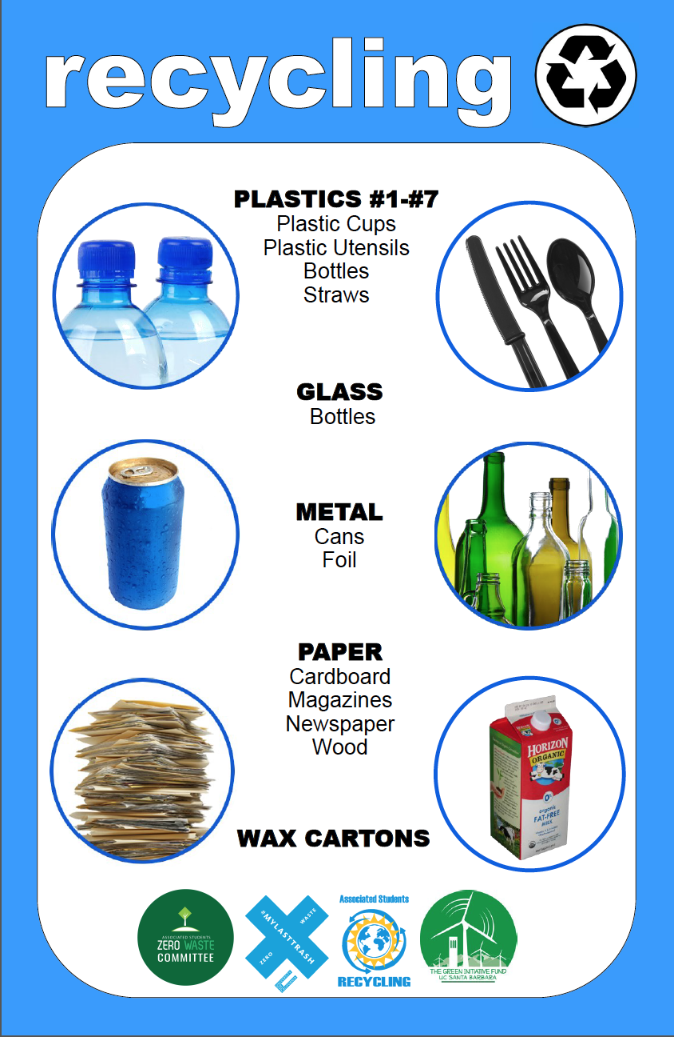
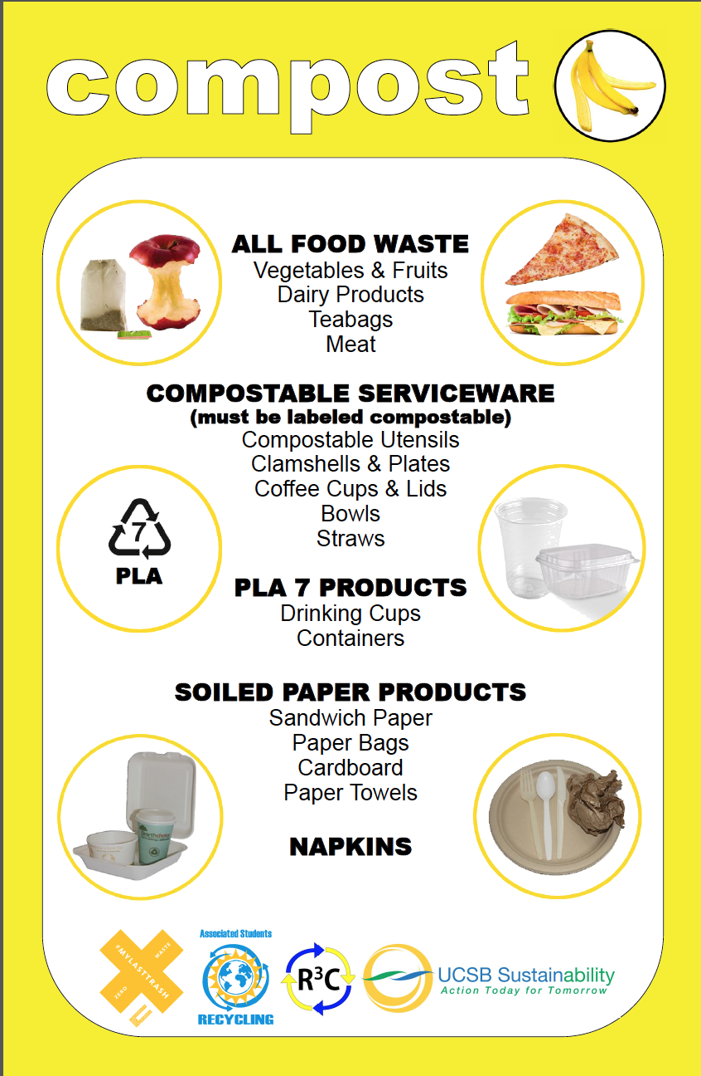

Slide 20
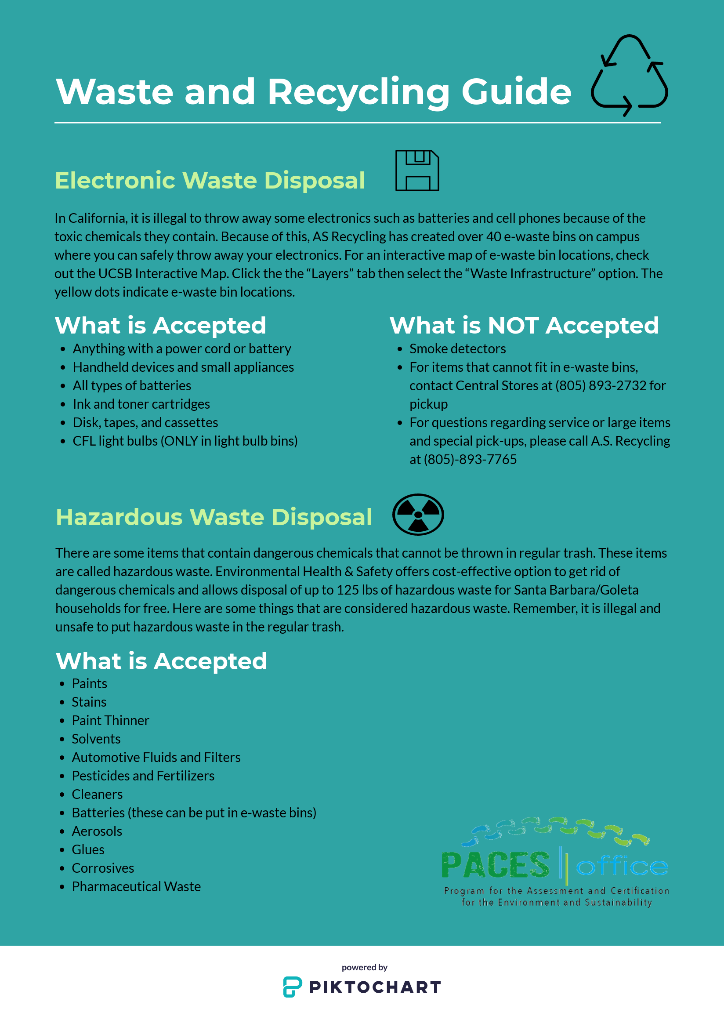

Slide 21
Water Areas of Improvement
45% of employees are unsure of how to report a leak
Employees are advised to contact their department MSO to bring the leak to the attention of facilities management

Slide 22
Indoor Environmental Quality Areas of Leadership
Many of the office spaces have been ergonomically analyzed
All potential pollutants and office equipment are kept away from food preparation and storage areas

Slide 23
Indoor Environmental Quality Areas of Improvement
94% of staff eat lunch at their desk daily. Refraining from this will decrease the chance of pests in the workplace
Purchase indoor plants for air filtration
Use Green Seal certified products when cleaning personal and public work stations

Slide 24
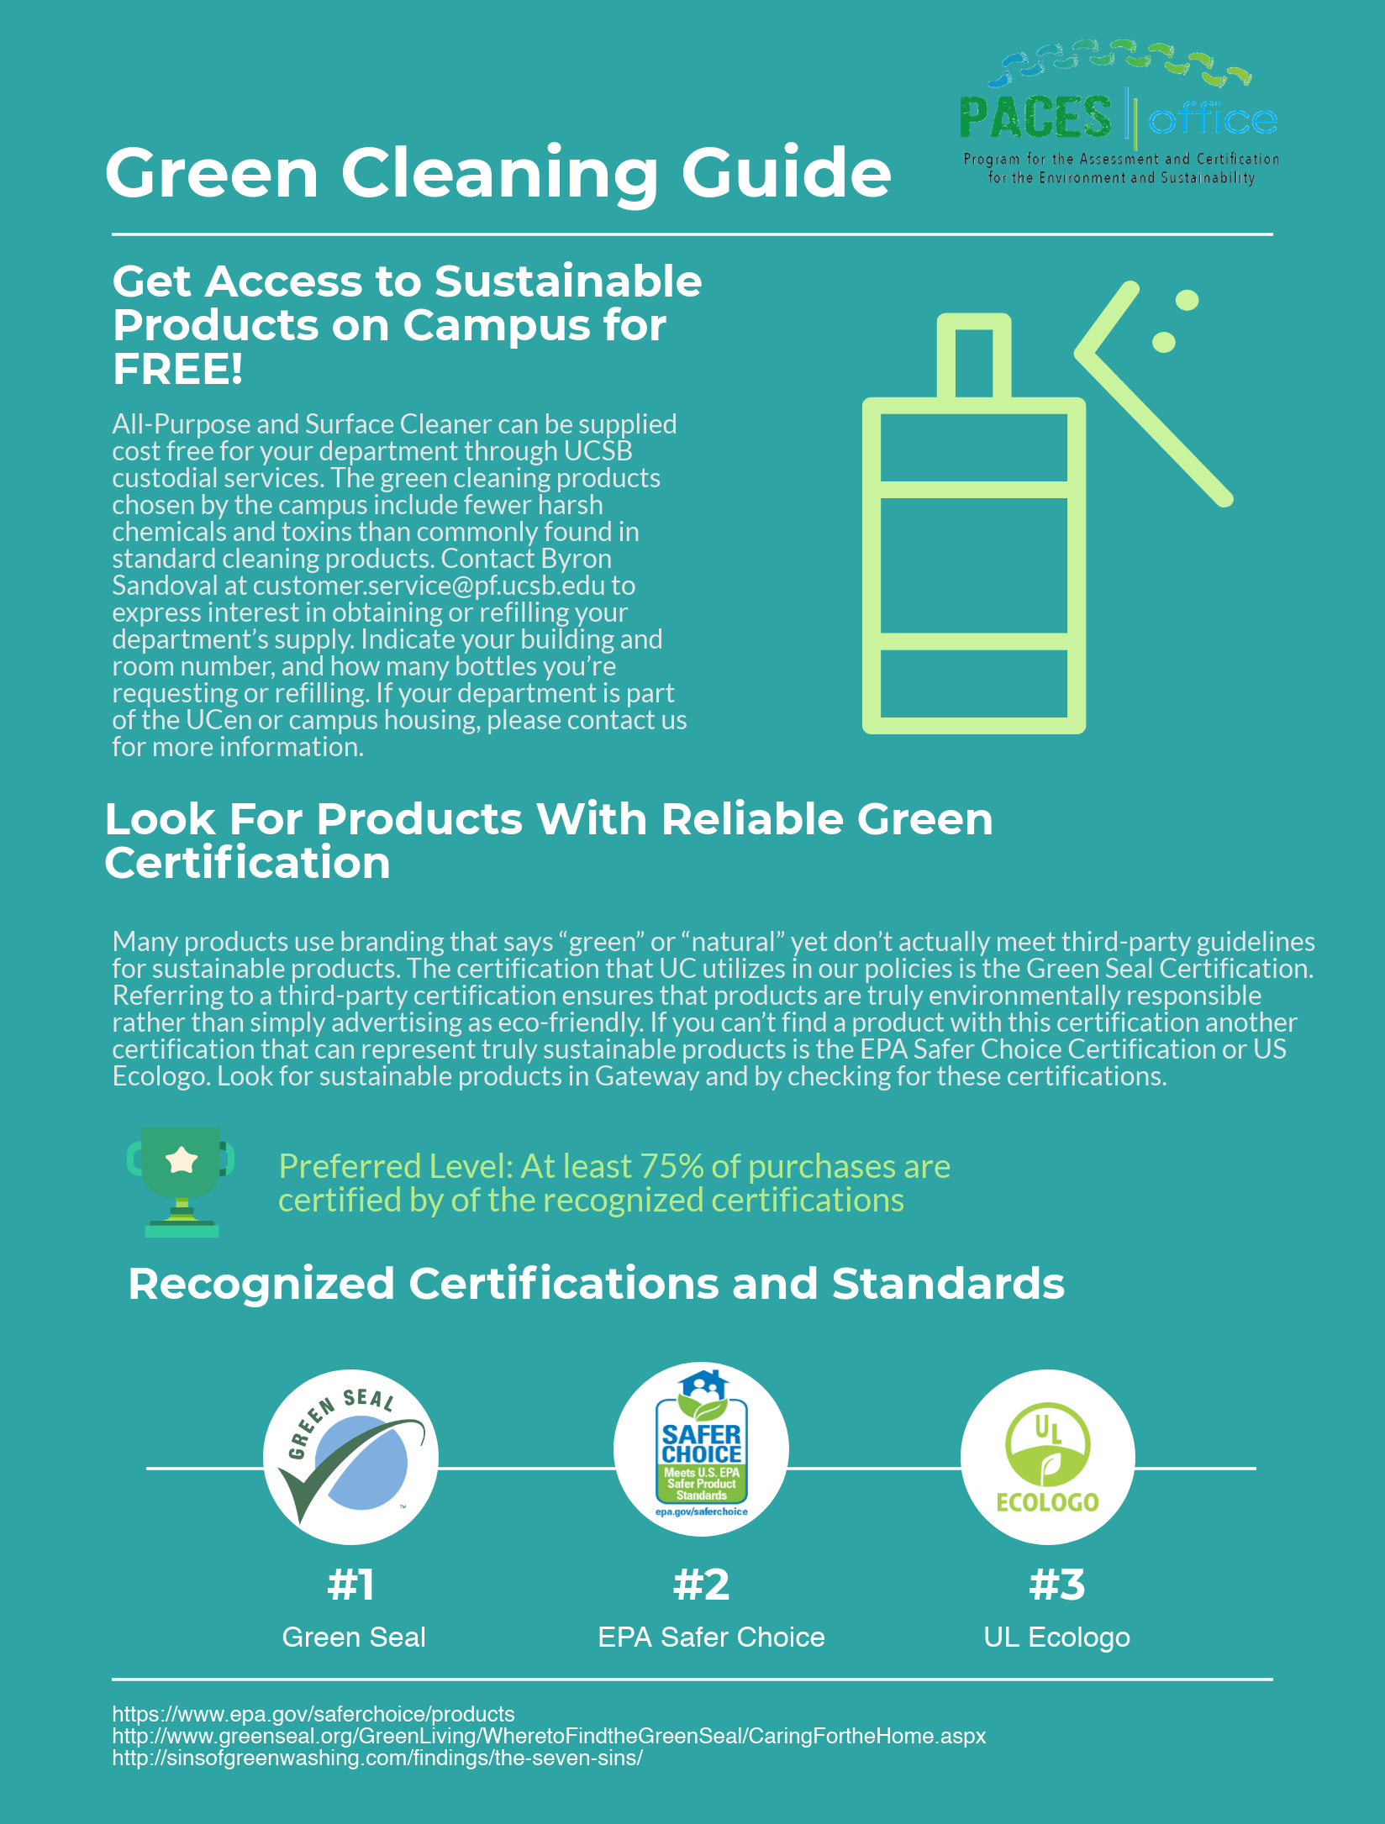

Slide 25
Human Health Areas of Improvement
63% of survey respondents indicated they would like the department to offer a health and fitness program
UCSB Recreation
FitSQUAD
UC Walks
Take the Stairs Campaign
Contact Healthy Campus Network Crew Member: Kristyn Keylon (Office of Financial Aid)

Slide 26
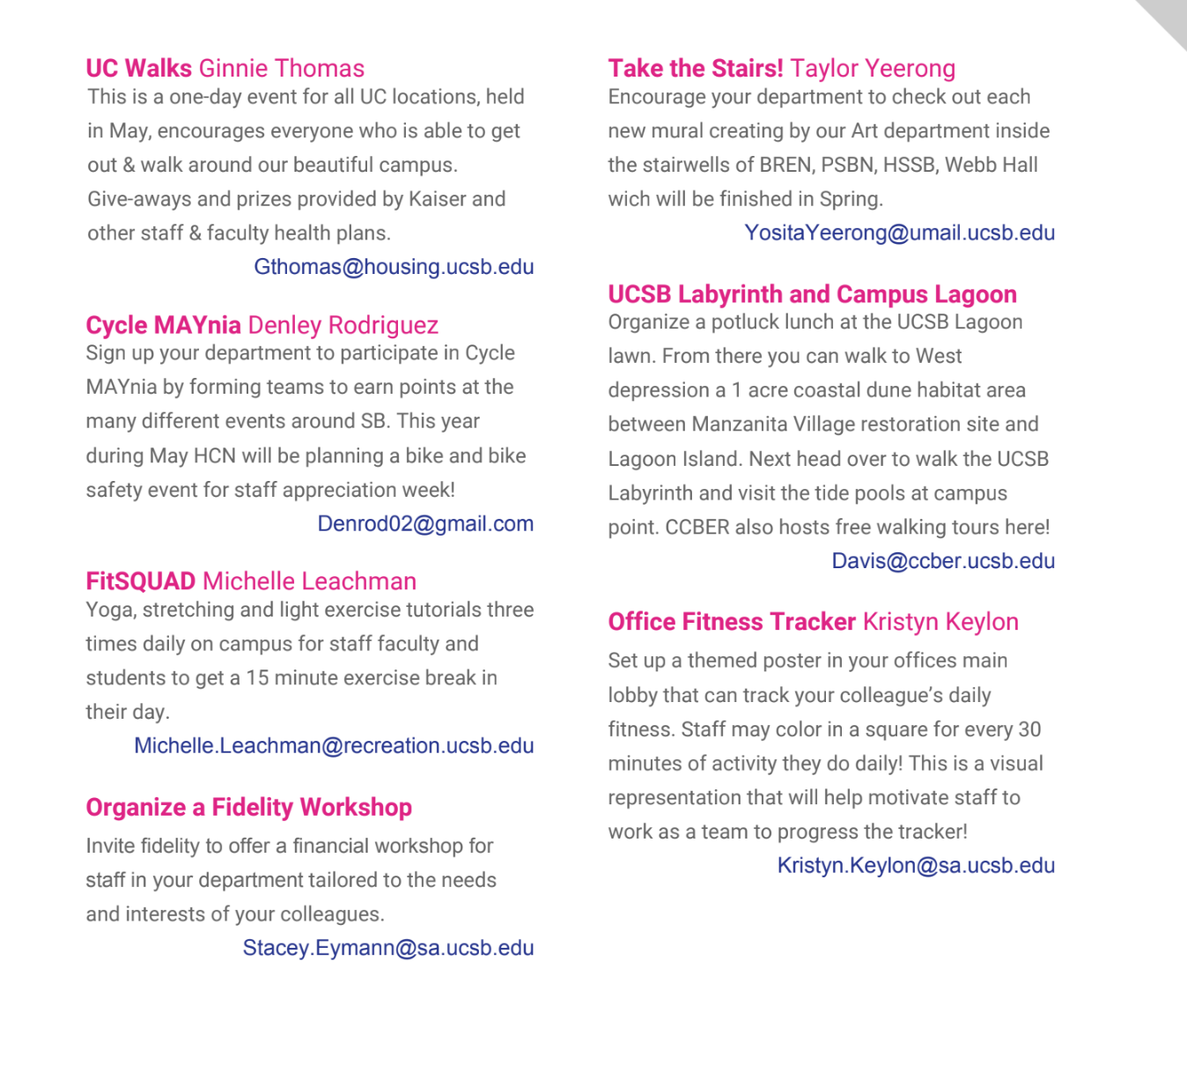

Slide 27
Overall…

Slide 28
PACES Scorecard
PACES uses the PACES Scorecard as a point system to keep track of the department’s practices and to gauge the overall environmentalism of the whole department.
8 sections:
Transportation
Energy and Atmosphere
Materials and Resources
Solid Waste Management
Food Systems
Water
Indoor Environmental Quality
Communication and Training
Bronze 25%
Silver 50%
Gold 75%
Enrollment Services earned:
39/86 (%) = 43%

Slide 29
Congratulations!
The Enrollment Services Unit is
Bronze Certified

Slide 30
Next Steps…

Slide 31
PACES Assessment Checklist

Slide 32
Transportation
Educate department on TAP program
Prioritize the possibility of video conferences rather than meeting for conferences
Energy and Atmosphere
Set at least 90% of departmental computers, monitors, and other devices to energy saving modes (Refer to power management guide)
Have at least 30% of the department unplug devices on a semi-regular basis or turn off power strips
Use natural lighting or task lighting instead of overhead lighting
Post reminder signs near light switches for spaces without occupancy sensors
Materials and Resources
Educate department on electronic and hazardous waste management
Replace 30% post consumer recycled paper (PCRP) with 50-100% PCRP
Continue requesting ENERGY STAR appliances and products like computers, copiers, fax machines, printers, scanners, and water cooler
Purchase task lamps to reduce the amount of overhead lighting
Purchase biodegradable utensils
Purchase products manufactured within 500 miles of UCSB
Purchase products with green certification

Slide 33
Waste Management
Implement pen recycling program and notify all departments within Enrollment Services
Replace paper cups with reusable cups for public water dispensers
Encourage department to use reusable water bottles
Continue the reusable washcloths protocol
Minimize the amount of waste from paper consumption by reducing print runs
Make sure there is a paired recycling and trash bin in kitchen areas
Food
Choose sustainable, local, fairtrade, and organic options when catering or purchasing food for small office events for at least 1 meal
Add a compost bin in kitchen spaces
Indoor Environmental Quality
Limit the amount of times you eat at your desk in the week to increase worker productivity and control the presence of pests
Use all-purpose green chemical provided by facilities for cleaning office space rather than lysol wipes (under materials and resources?) or other Green Seal certified cleaning products
Encourage department to participate in exercise programs and activities
Communication and Training
Provide sustainability resources and information through a bulletin board or electronic listserv
Incorporate sustainability information into staff meetings

Slide 34
Earn Silver Certification!
The department can reach Silver certification by modifying their operations by:
Enabling energy saving measures on more than 90% of departmental computers
Having at least 30% of the department unplug devices on a semi-regular basis or turn off power strips
Posting reminder signs in at least 60% of departmental managed space
Making sure at least 75% of surface cleaners that are Green Seal certified
Replace 30% post-consumer recycled content (PCRC) paper with 50% PCRC

Slide 35
Thank you
For questions, comments, or inquires, please contact:
Ryann Jeff Malicdem
PACES Green Office Coordinator
Rmalicdem18@gmail.com

