Slide 1
A Sustainable Focus:
Setting the stage for tomorrow.
Central Coast Sustainability Conference OCT 2015
Len Hering, RADM, USN (ret), Executive Director

Slide 2
CSE Mission: Accelerate the transition to a sustainable world, powered by clean energy

Slide 3
3 Reasons for a Sustainable Future
What are yours?

Slide 4
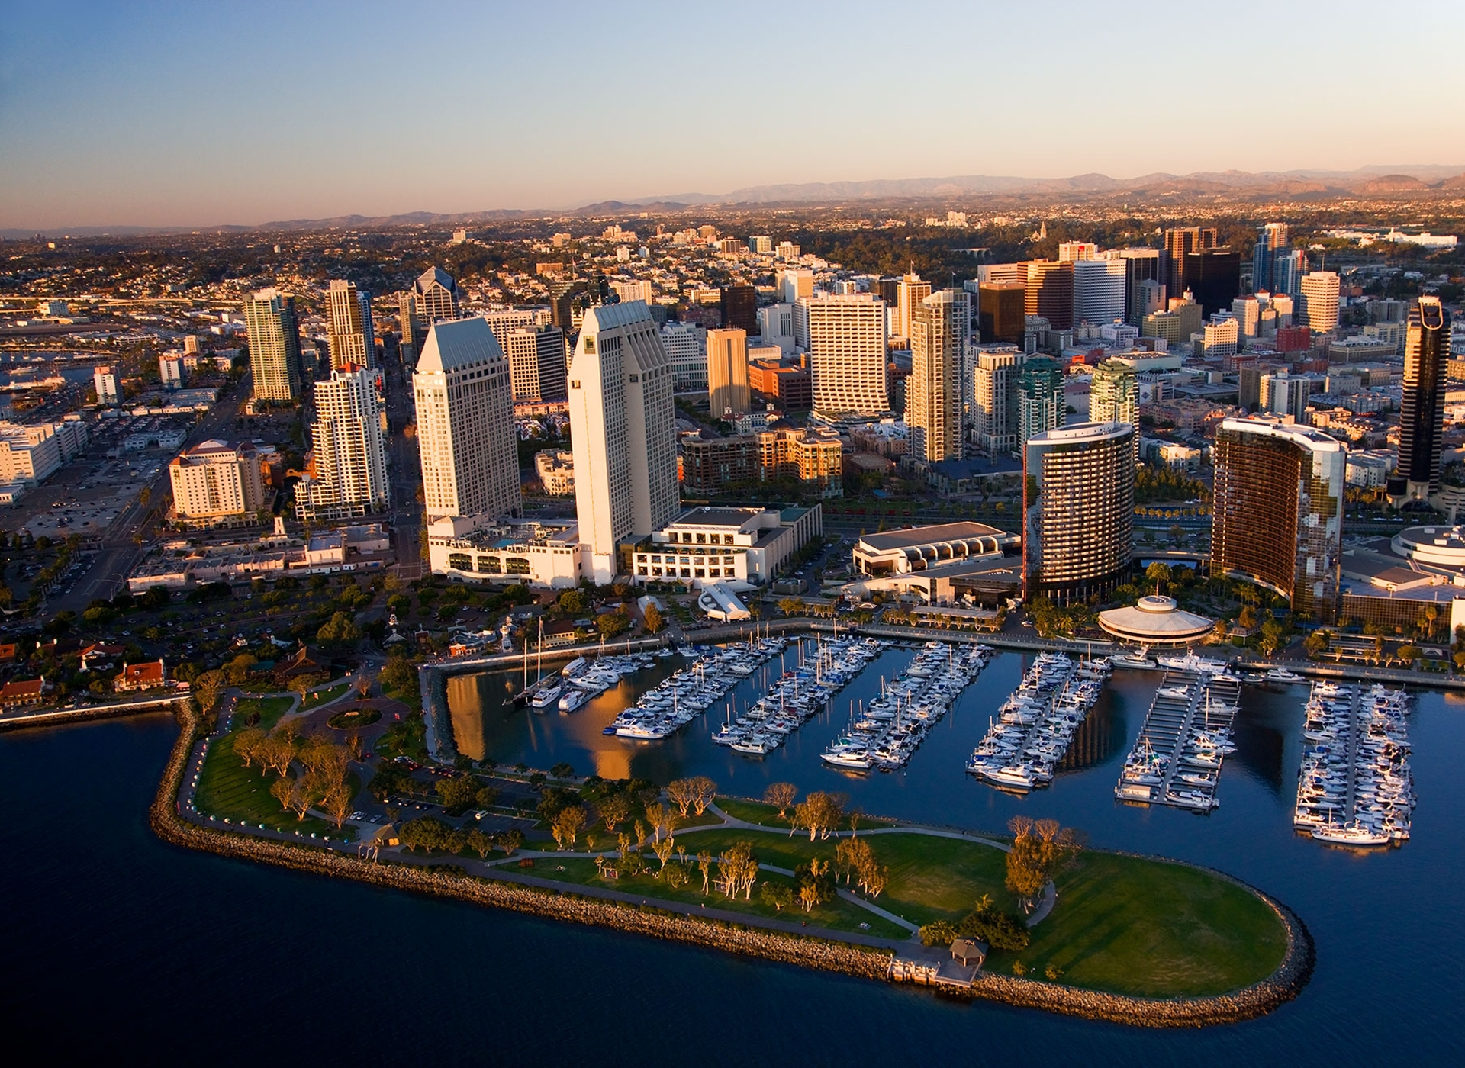
How sustainable are we?
Reflecting on energy and AB 32

Slide 5
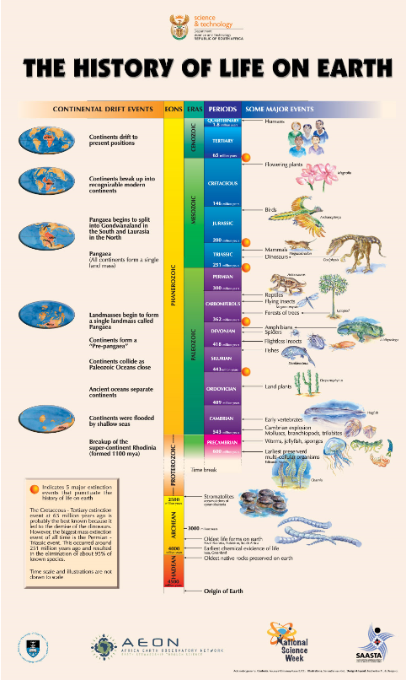
Placing things in perspective
If this scale represented an entire year of time (365 days) man has been on the face of the earth for less than a minute!

Slide 6
Simple supply and demand.

Slide 7
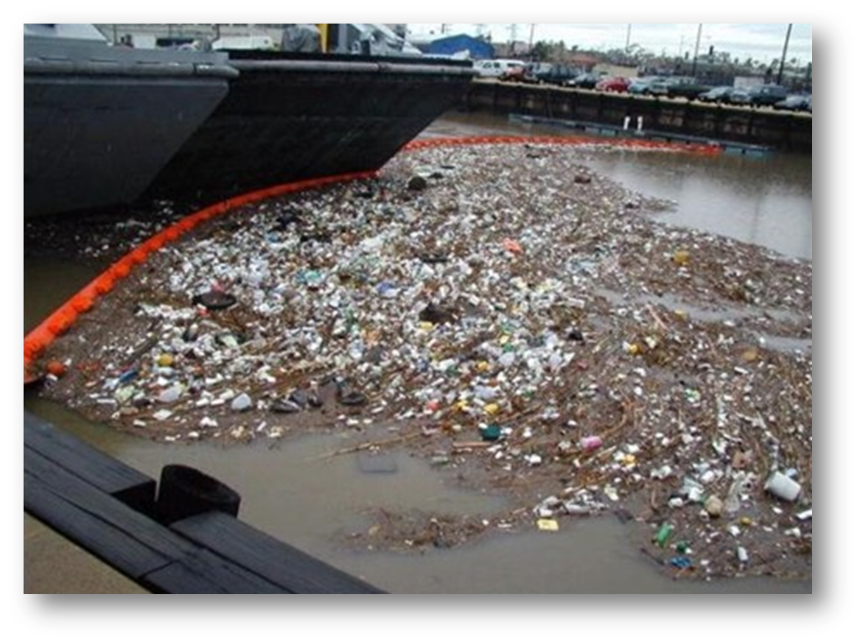
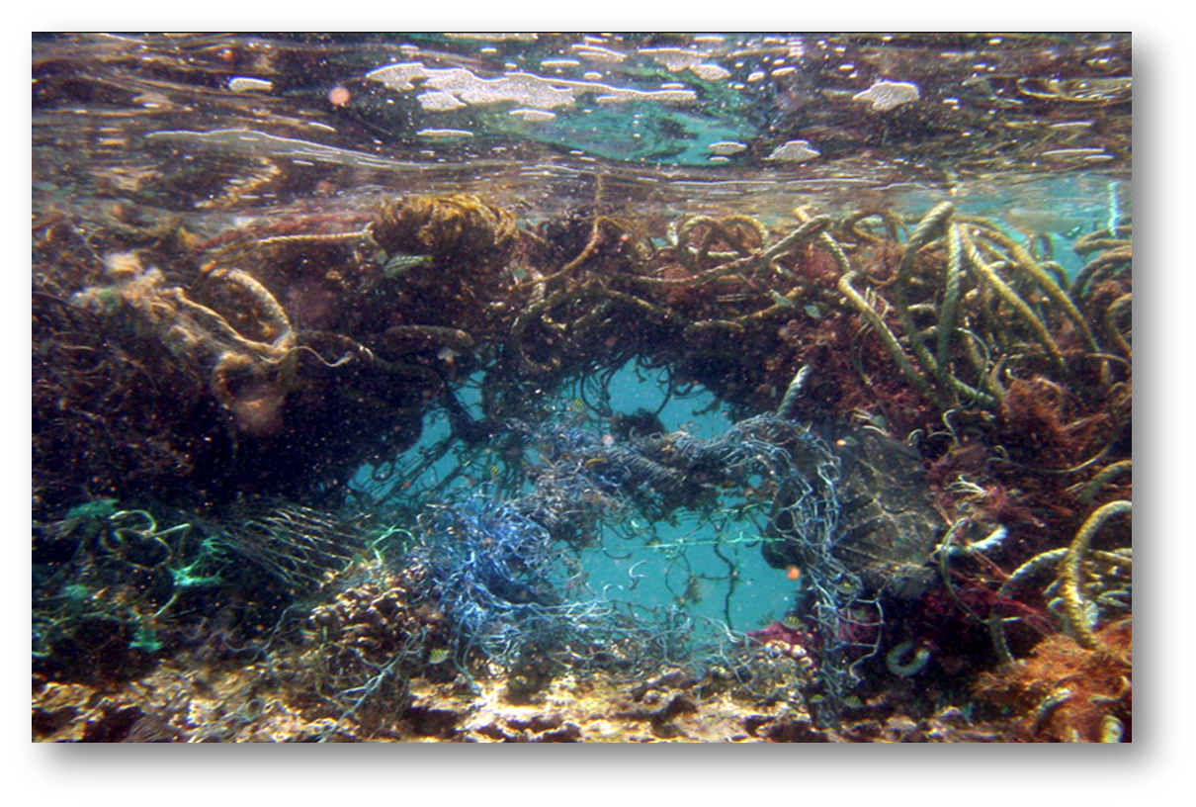
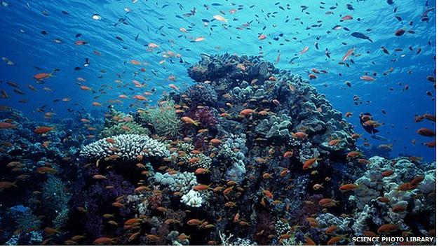
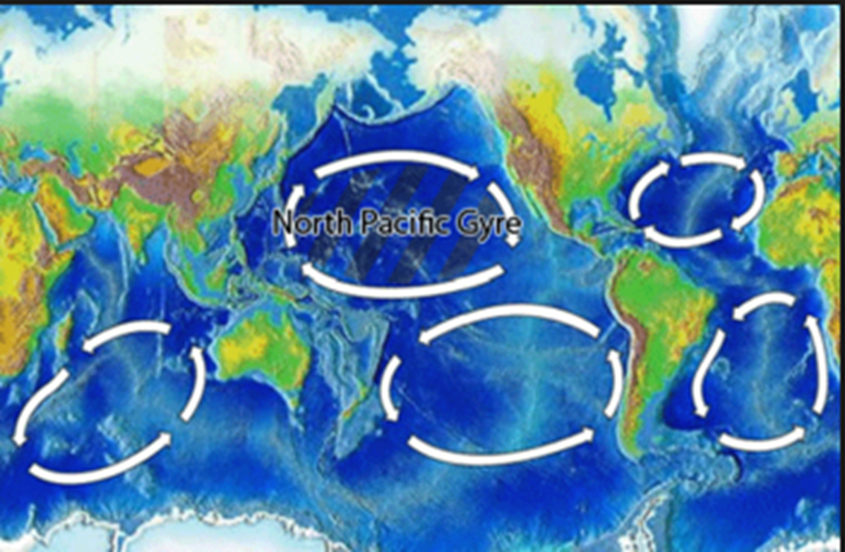
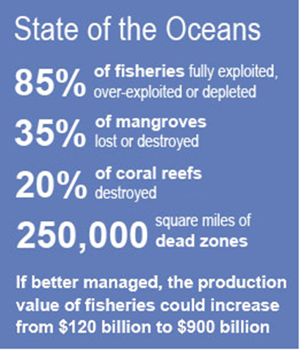
Our Ocean’s Health
Where life itself evolved

Slide 8
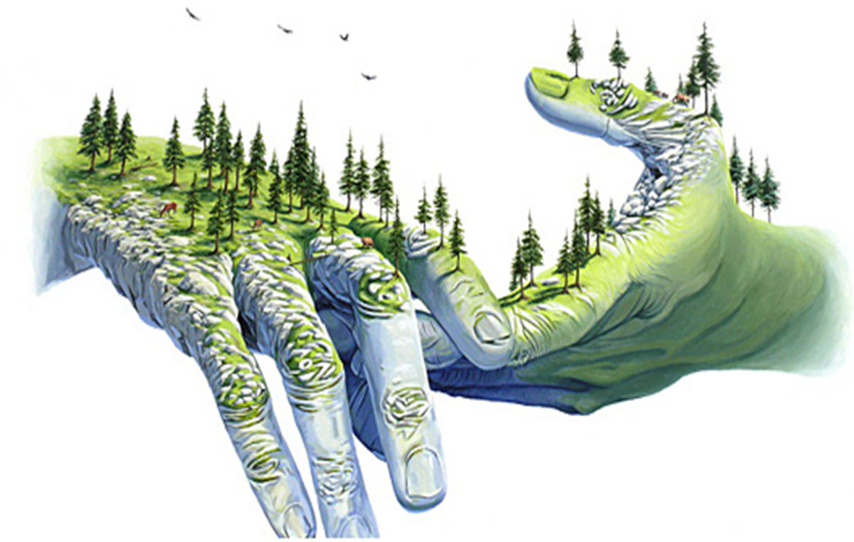
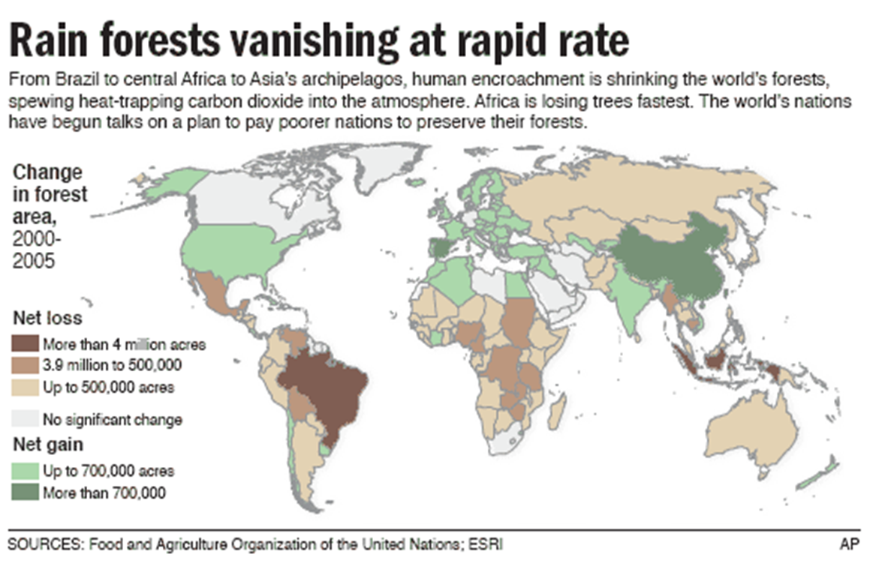
Man and Nature.
Humanity and Nature

Slide 9
The basic element of life: fresh water

Slide 10
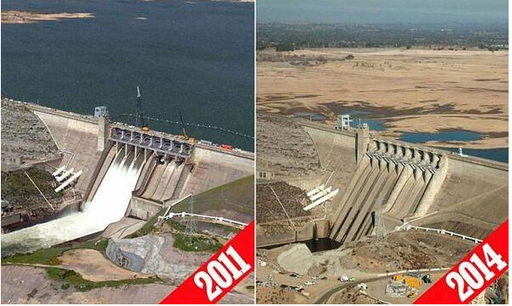
Things are Bad and Getting Worse

Slide 11
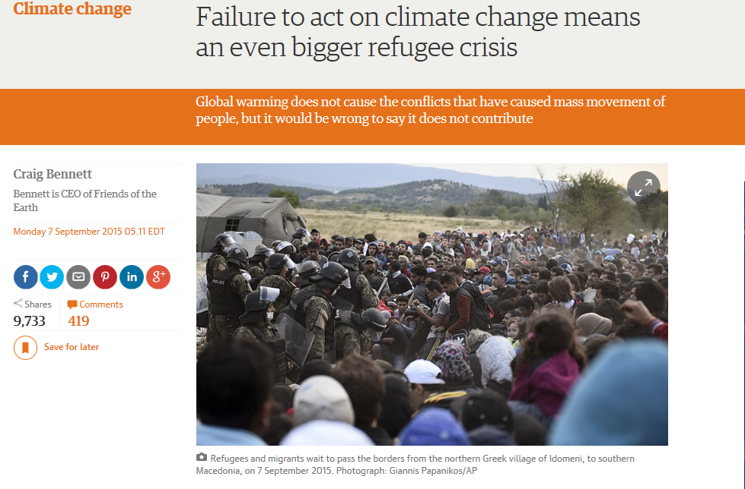
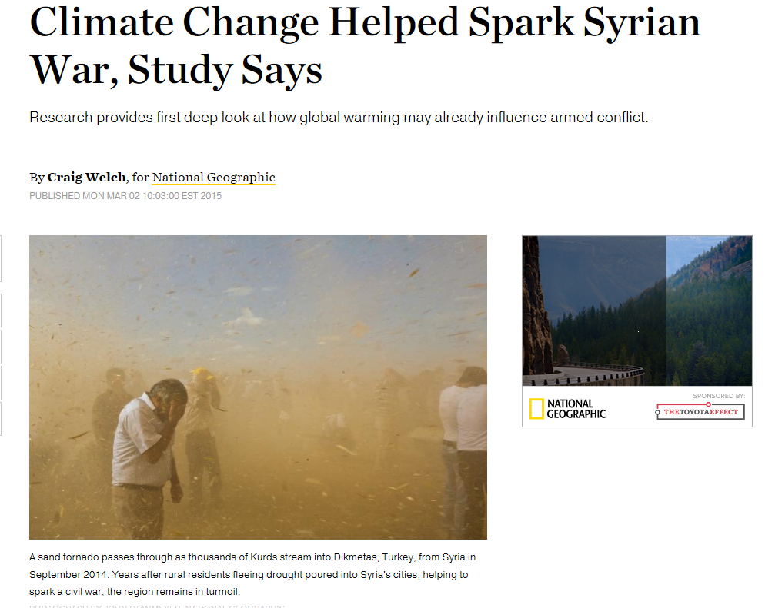
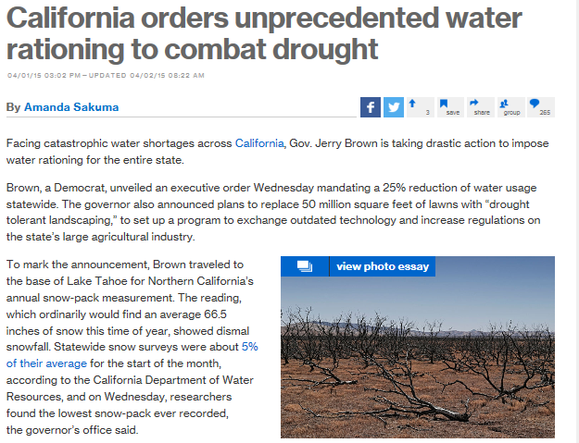
Devastation on a grand scale
Australian farmers are forced to make a difficult decision.
“If water allocations are not rebalanced and restored to California,
35% of the states dairy farms may be forced to close in 2015.”

Slide 12
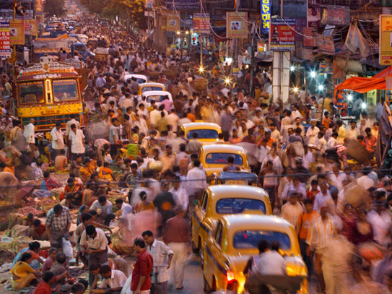
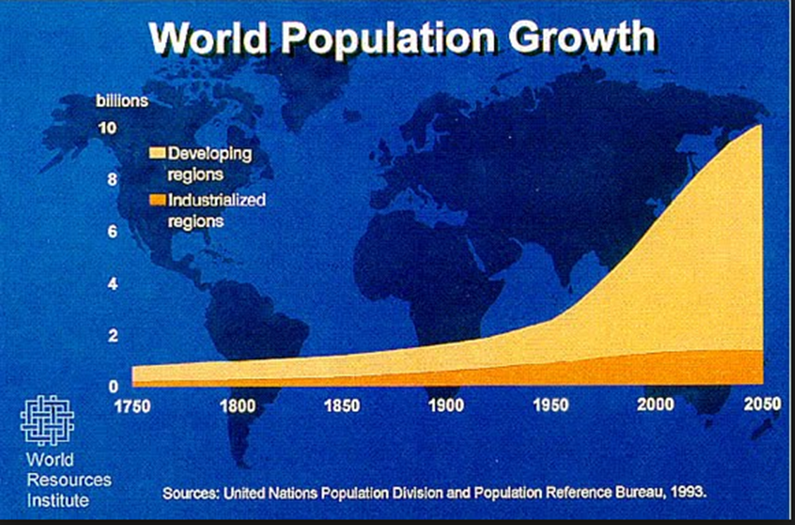
This is the equivalent of adding a China and India to the face of the globe in the next 40 years.
Population Explosion & Its Effects

Slide 13
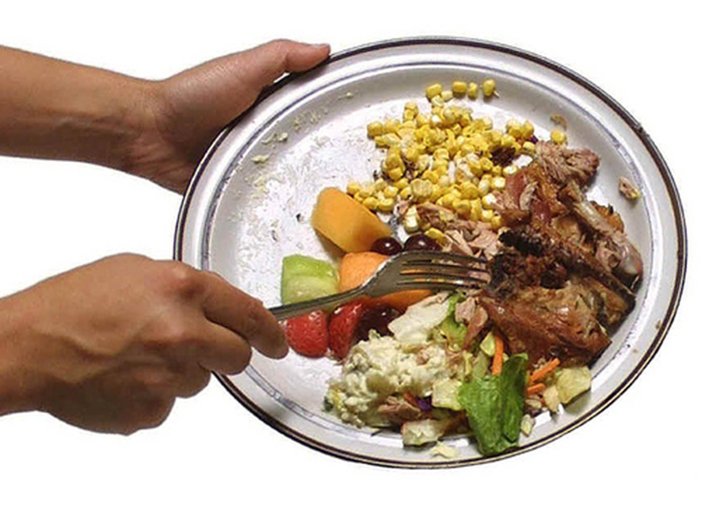
Food Supply
Excess taken to a new level

Slide 14
While the rest of the world starves

Slide 15
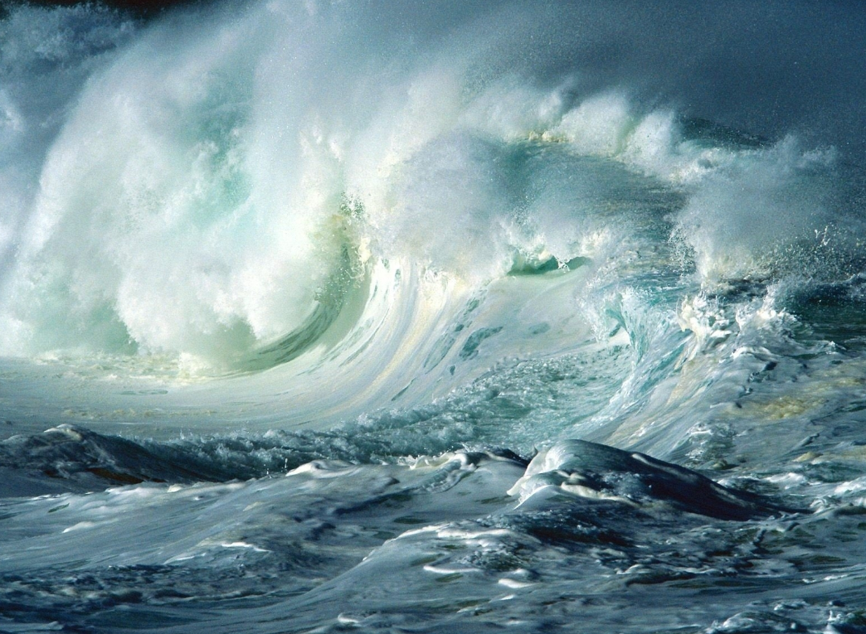
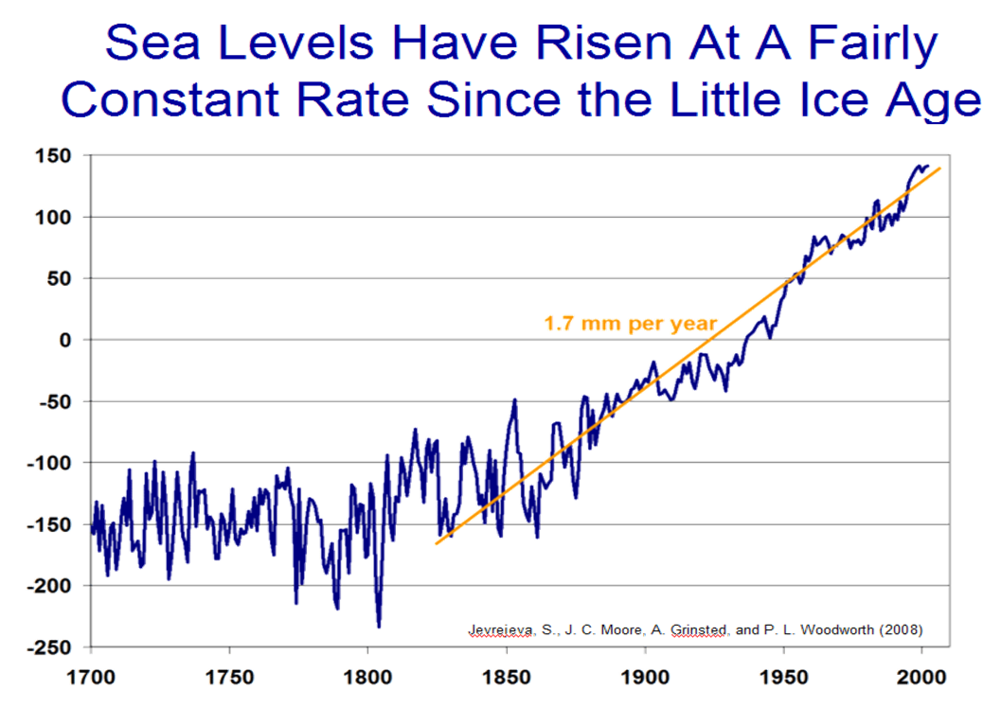
Sea Level Rise & Its Effects

Slide 16
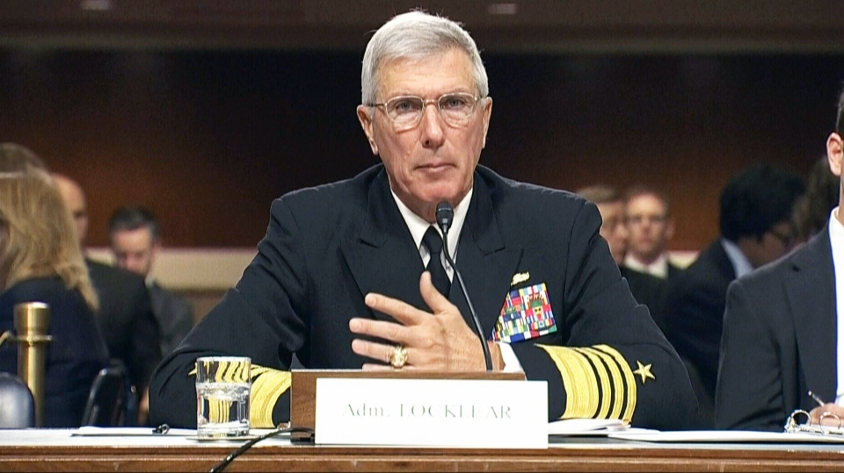
Climate change is the biggest
long-term security threat in the Pacific region.”
Admiral Sam Locklear, Commander U.S. Pacific Command
Notes:
Are we sustainable if we continue down the path built by our grandfathers in a different time and a different environment? I fear not.

Slide 17
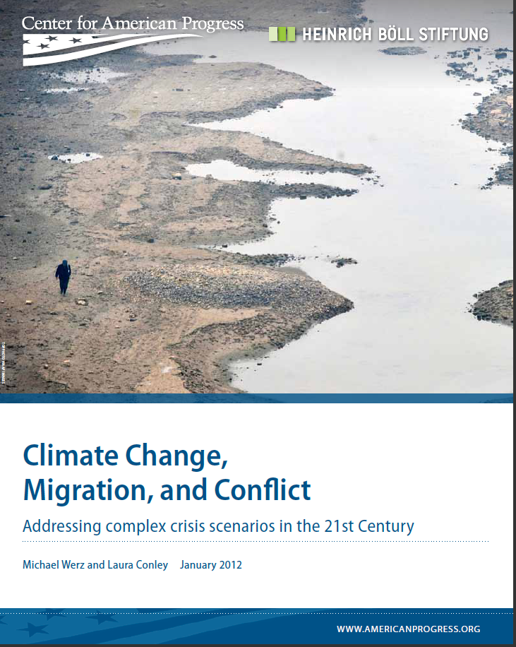
Experts Agree, it’s not if, it’s when.

Slide 19
Where the rubber meets the road

Slide 20
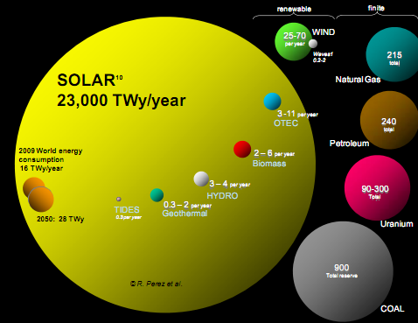

Slide 21
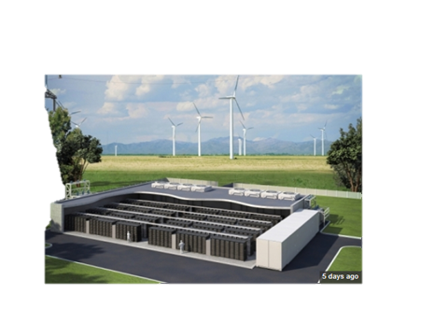
Where there’s wind there’s energy
Combine it with storage and there’s
independence and security

Slide 22
Geothermal, harnessing the earths own energy source

Slide 23
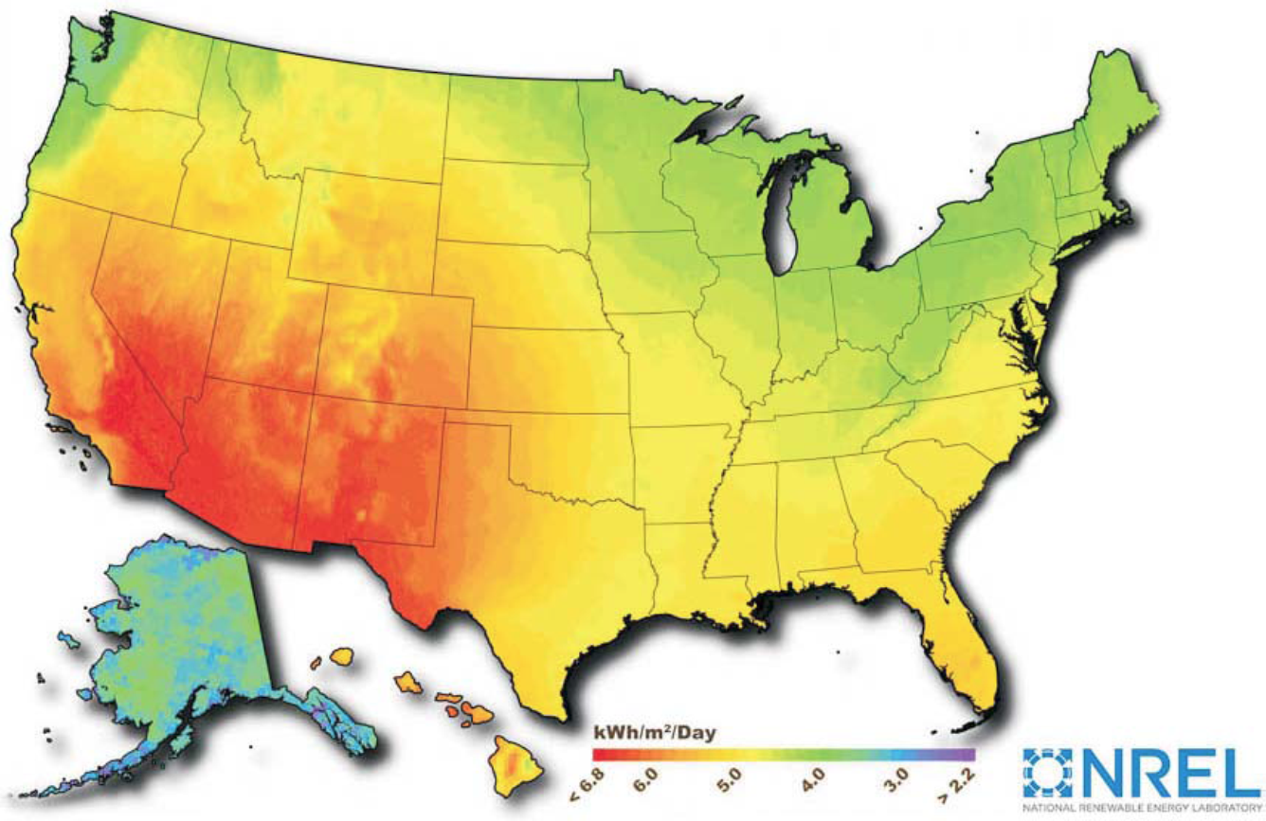
U.S. is a solar rich environment

Slide 24
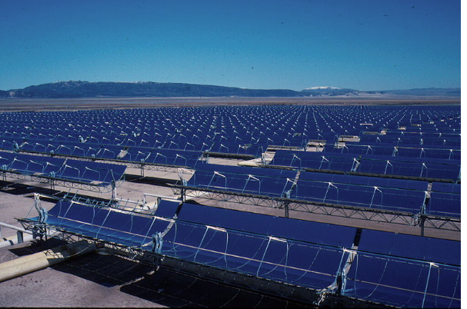
Utility Scale Solar

Slide 25
Schools, Businesses and Colleges

Slide 26
Residential solar and small scale distributed generation

Slide 28
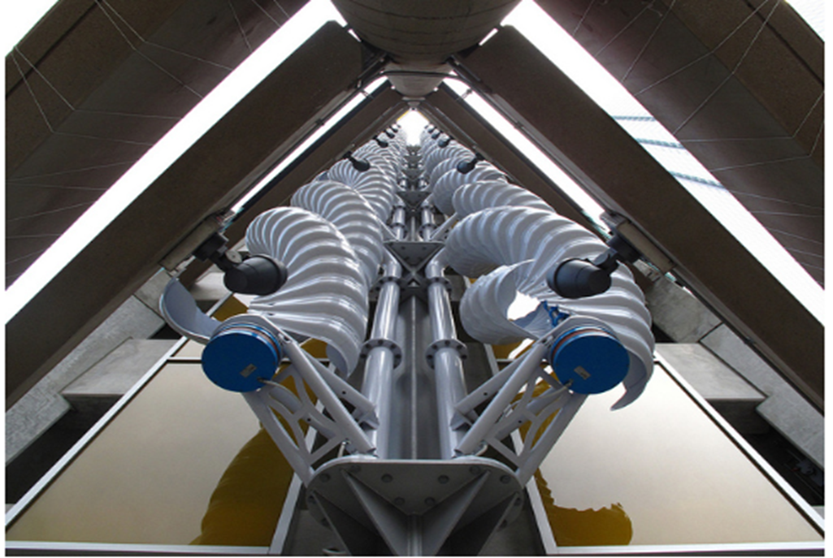
It can even be artistic

Slide 29
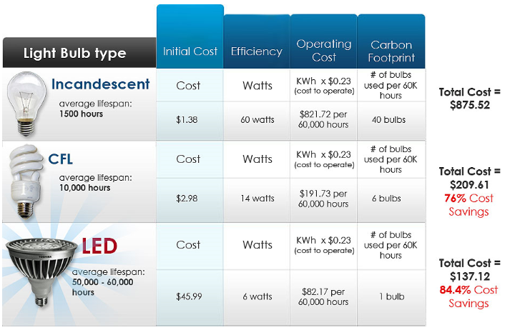
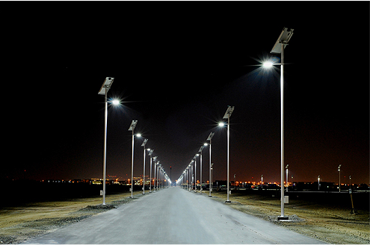
Lighting the way can be a revolution.
$92.40
90.6% Cost savings
$10.23

Slide 30
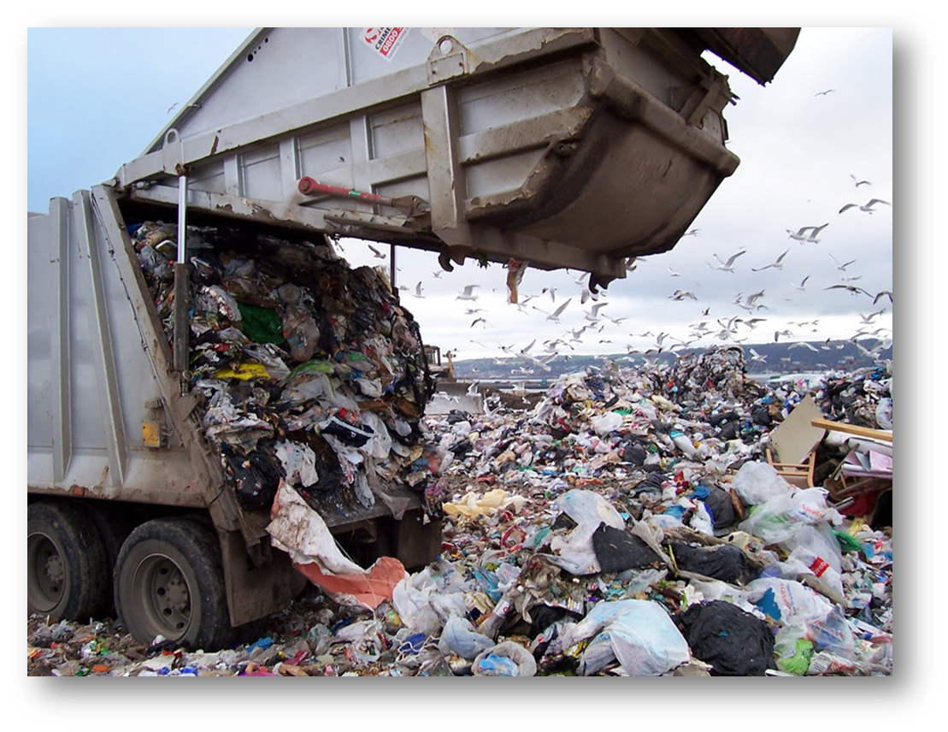
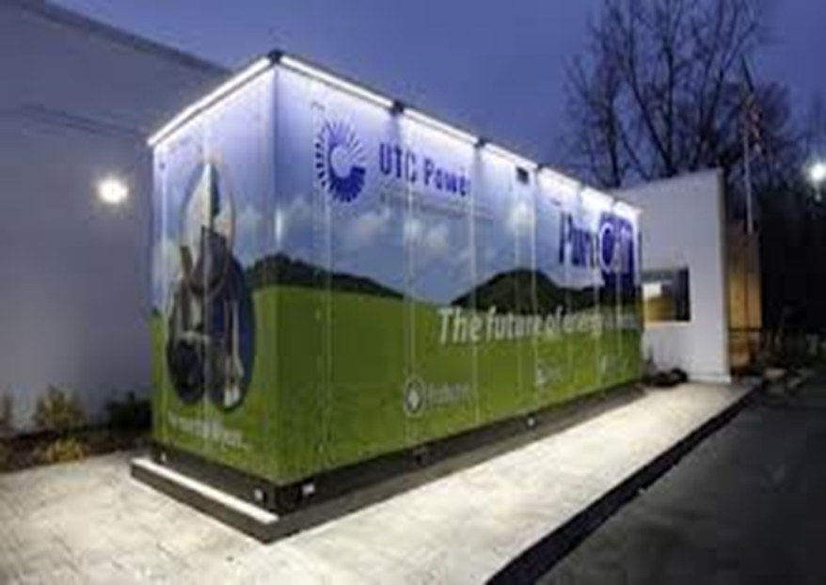
Convert for a smarter future
Co-locate for a higher more efficient use

Slide 31
Take recycling serious

Slide 32
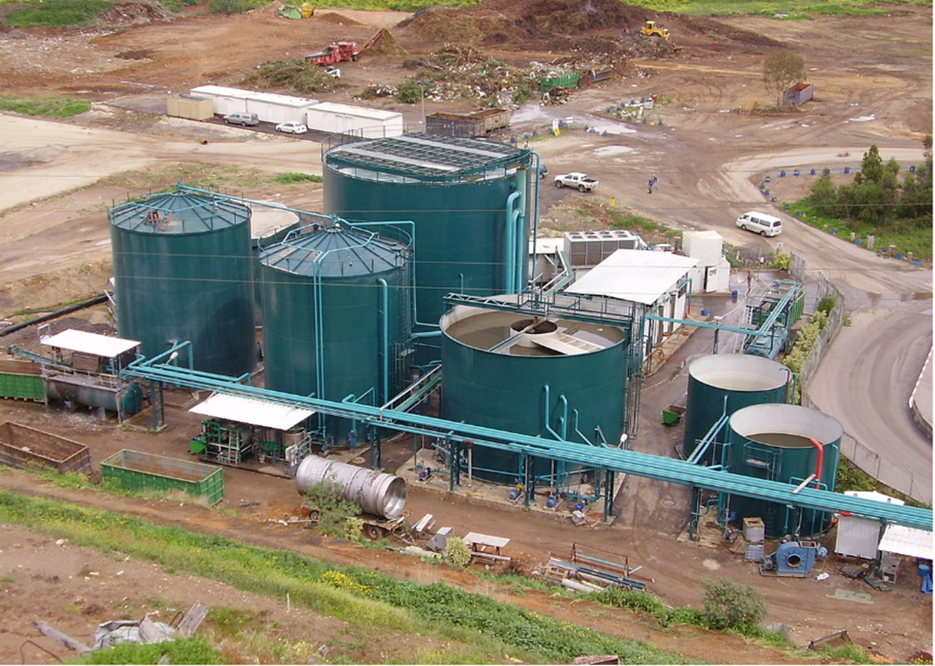
Think differently about the future; alter behaviors

Slide 33
Smartscape where it make sense

Slide 34
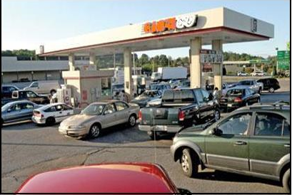
Change in the making

Slide 35
Solutions abound

Slide 36
Some are ahead of the curve

Slide 37
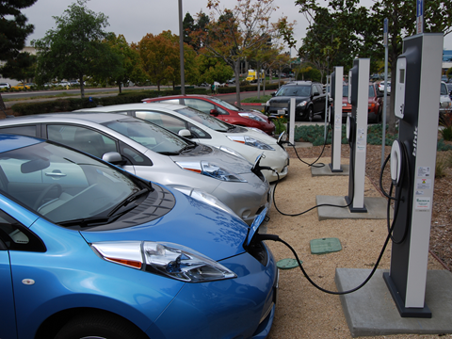
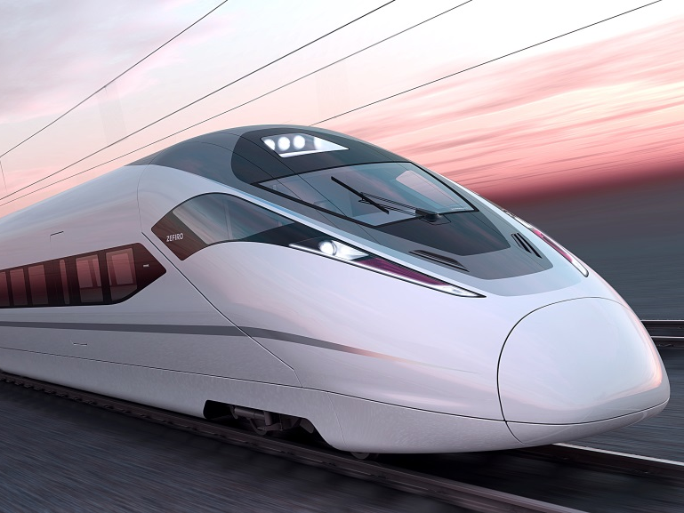
Every reduction and change counts

Slide 38
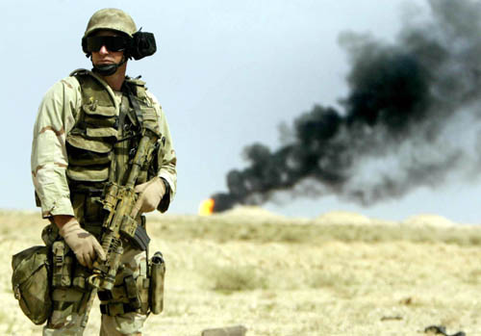
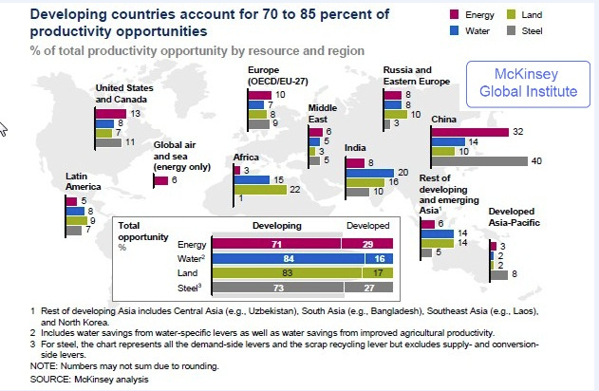
Title/Main Point
The 20th Century: Bloodiest in History
Can we avoid a similar fate for the 21st century?

Slide 39
3 Reasons for a Sustainable Future
What are yours?

Slide 40
energycenter.org.
Notes:
When it’s all said and done, earth will survive man’s abuse, question is will man survive given the course of action needed to chart a new course?

