Slide 1
Potable Reuse: A New Water Resource for the Central Coast
Water Breakout Session –
2015 Central Coast Sustainability Summit
James Hawkins, Heal the Ocean

Slide 2
Potable Reuse
Potable reuse encompasses all water reuse systems in which wastewater undergoes advanced treatment to produce a source of highly treated, purified water for ultimate use as a source of drinking water.

Slide 3
Three Numbers on the Drought
Zero Percent
Five
Four Years

Slide 4
Three Numbers on the Drought
Zero Percent
State Water Project

Slide 5
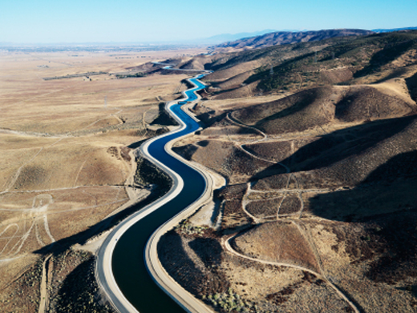
State Water Project

Slide 6
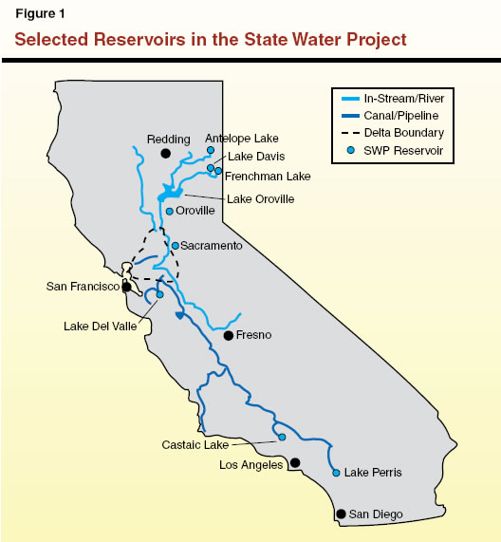

Slide 7
State Water Project Allocations
ZERO PERCENT

Slide 8
State Water Project

Slide 9
Three Numbers on the Drought
Zero Percent
Original 2014 State Water Project Allocation
Five
State Water Rights System

Slide 10
State Water Rights System
Legal basis for who gets water in California and how much.
Senior water rights hold priority.
All water rights must be put to a “reasonable and beneficial use.”
Arcane -- “understood by few; mysterious or secret.”

Slide 11
“The results show that water right allocations total 400 billion cubic meters, approximately five times the state’s mean annual runoff.”

Slide 12
Three Numbers on the Drought
Zero Percent
Original 2014 State Water Project Allocation
Five
State Water Rights System is Five Times Over-Subscribed

Slide 13
Three Numbers on the Drought
Zero Percent
Original 2014 State Water Project Allocation
Five
State Water Rights System is Five Times Over-Subscribed
Four Years
Cachuma

Slide 14
What About Cachuma?
The number of years that Cachuma water deliveries are meant to last during drought periods.
Seven Years
Notes:
http://www.noozhawk.com/article/california_drought_lake_cachuma_water_deliveries_20150802
http://www.independent.com/news/2015/sep/24/lake-cachuma-drops-175-capacity/

Slide 15
What About Cachuma?
The number of years that water deliveries are projected to last in the current drought period.
Four Years
Notes:
http://www.noozhawk.com/article/california_drought_lake_cachuma_water_deliveries_20150802
http://www.independent.com/news/2015/sep/24/lake-cachuma-drops-175-capacity/

Slide 16
Three Numbers on the Drought
Zero Percent
Original 2014 State Water Project Allocation
Five
State Water Rights System is Five Times Over-Subscribed
Four Years
Number of Years Cachuma has Lasted in Current Drought

Slide 17
Intensifying Impacts of Climate Change
“Global warming caused by human emissions has most likely intensified the drought in California by 15 to 20 percent, scientists said on Thursday, warning that future dry spells in the state are almost certain to be worse than this one as the world continues to heat up.”

Slide 18
Where do we go from here?
Demand Management
Supply Management
Mandatory Conservation
Low Flow Appliances
Landscaping Rebates
Water Recycling
Groundwater
Surface Reservoirs
Desalination

Slide 19
Where do we go from here?
Demand Management
Supply Management
Mandatory Conservation
Low Flow Appliances
Landscaping Rebates
Water Recycling
Groundwater
Surface Reservoirs
Desalination

Slide 20
Where do we go from here?
Demand Management
Supply Management
Mandatory Conservation
Low Flow Appliances
Landscaping Rebates
Water Recycling
Groundwater
Surface Reservoirs
Desalination

Slide 21
Where do we go from here?
Demand Management
Supply Management
Mandatory Conservation
Low Flow Appliances
Landscaping Rebates
Water Recycling
Groundwater
Surface Reservoirs
Desalination

Slide 22
Conservation
Between August 2014 and July 2015 Santa Barbara County South Coast water users have saved:
3.2 Billion Gallons
33% Reduction in Water Use

Slide 23
Where do we go from here?
Demand Management
Supply Management
Mandatory Conservation
Low Flow Appliances
Landscaping Rebates
Water Recycling
Groundwater
Surface Reservoirs
Desalination

Slide 24
Potable Reuse
Potable reuse encompasses all water reuse systems in which wastewater undergoes advanced treatment to produce a source of highly treated, purified water for ultimate use as a source of drinking water.

Slide 25
Potable Reuse
Indirect Potable Reuse (IPR)
Direct Potable Reuse (DPR)

Slide 26
Indirect Potable Reuse
Advanced Treatment
Municipal Drinking Water Plant
Environmental Buffer (Groundwater)
Purified Water

Slide 27
Direct Potable Reuse
Advanced Treatment
Municipal Drinking Water Plant
Engineered Storage Buffer (Reservoir)
Purified Water

Slide 28
Indirect Potable Reuse
Advanced Treatment
Municipal Drinking Water Plant
Environmental Buffer (Groundwater)
Purified Water

Slide 29
Potable Reuse
1) Potable Reuse is Safe
2) Potable Reuse is Affordable
3) Potable Reuse is Environmentally Sustainable

Slide 30
Potable Reuse
1) Potable Reuse is Safe
2) Potable Reuse is Affordable
3) Potable Reuse is Environmentally Sustainable

Slide 31
Producing Purified Water
via Advanced Treatment
Notes:
http://www.gwrsystem.com/images/stories/pdfs/Fact%20SheetFINALReduced.11.5.10.pdf
https://en.wikipedia.org/wiki/Membrane_technology

Slide 32
Producing Purified Water
via Advanced Treatment
.2 micrometers thick
300 times more narrow than human hair
Removes bacteria and larger particles
Notes:
Human Hair: http://hypertextbook.com/facts/1999/BrianLey.shtml
Microfiltration (1/300 diameter of human hair): http://www.gwrsystem.com/images/stories/pdfs/Fact%20SheetFINALReduced.11.5.10.pdf
Human Hair = 60 micrometers

Slide 33
Producing Purified Water
via Advanced Treatment
Less than .0001 micrometers thick.
2,000 times smaller membrane than microfiltration.
Removes viruses and chemicals.
Notes:
https://www.youtube.com/watch?v=aVdWqbpbv_Y
http://www.certainwaterservice.com/custom-ro-system/
Human Hair = 60 micrometers thick
Reverse Osmosis = .0001 micrometers thick

Slide 34
Producing Purified Water
via Advanced Treatment
Disinfection against any remaining pathogens.
Advanced oxidation removes more resistant CECs.

Slide 35
Producing Purified Water
via Advanced Treatment
Used to recharge groundwater in IPR projects.
2 month retention time before use in drinking water system.
High quality, purified water.

Slide 36
Producing Purified Water
via Advanced Treatment
Notes:
http://www.gwrsystem.com/images/stories/pdfs/Fact%20SheetFINALReduced.11.5.10.pdf
https://en.wikipedia.org/wiki/Membrane_technology

Slide 37
Potable Reuse
1) Potable Reuse is Safe
2) Potable Reuse is Affordable
3) Potable Reuse is Environmentally Sustainable

Slide 38
Health & Safety of Potable Reuse
National Research Council found that potable reuse is as safe or safer than traditional water supplies;
Successfully demonstrated in U.S. and other countries;
More advanced than conventional drinking water treatment;
Consistently meet federal and state drinking water standards.

Slide 39
Potable Reuse
1) Potable Reuse is Safe
2) Potable Reuse is Affordable
3) Potable Reuse is Environmentally Sustainable

Slide 40
Potable Reuse as an Affordable Supply

Slide 41
Potable Reuse as an Affordable Supply
Orange County Water District Groundwater Replenishment System
$850/AF

Slide 42
Potable Reuse as an Affordable Supply
Orange County Water District Groundwater Replenishment System
$478/AF

Slide 43
Potable Reuse as an Affordable Supply
Construction Grants
35% up to $15 million
Low Interest Loans
1% financing
Facilities Planning Grants
75% up to $75k

Slide 44
Potable Reuse
1) Potable Reuse is Safe
2) Potable Reuse is Affordable
3) Potable Reuse is Environmentally Sustainable

Slide 45
Potable Reuse is Environmentally Sustainable

Slide 46
Potable Reuse is Environmentally Sustainable
Imported water requires significant energy to transport
Desalination up to 4 times more energy intensive than potable reuse
Far more salt content in ocean water than wastewater
Potable reuse achieves broader definition of sustainability by reusing a wasted resource

Slide 47
Potable Reuse
1) Potable Reuse is Safe
2) Potable Reuse is Affordable
3) Potable Reuse is Environmentally Sustainable

Slide 48
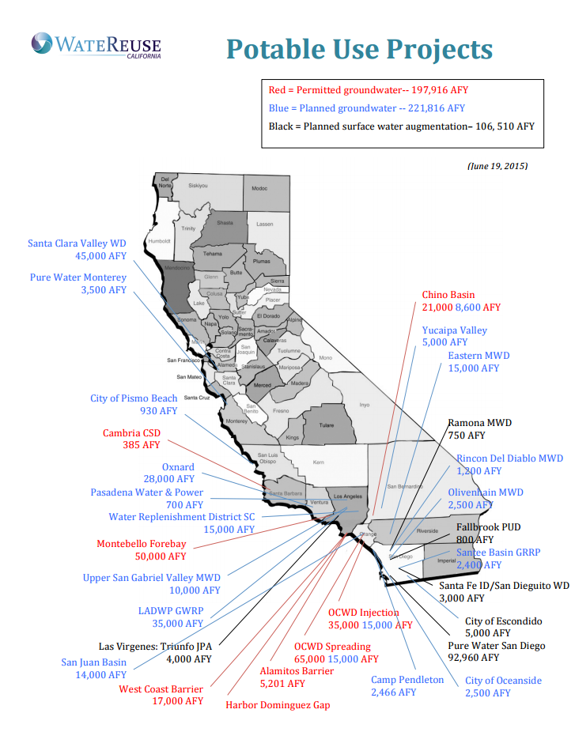

Slide 49
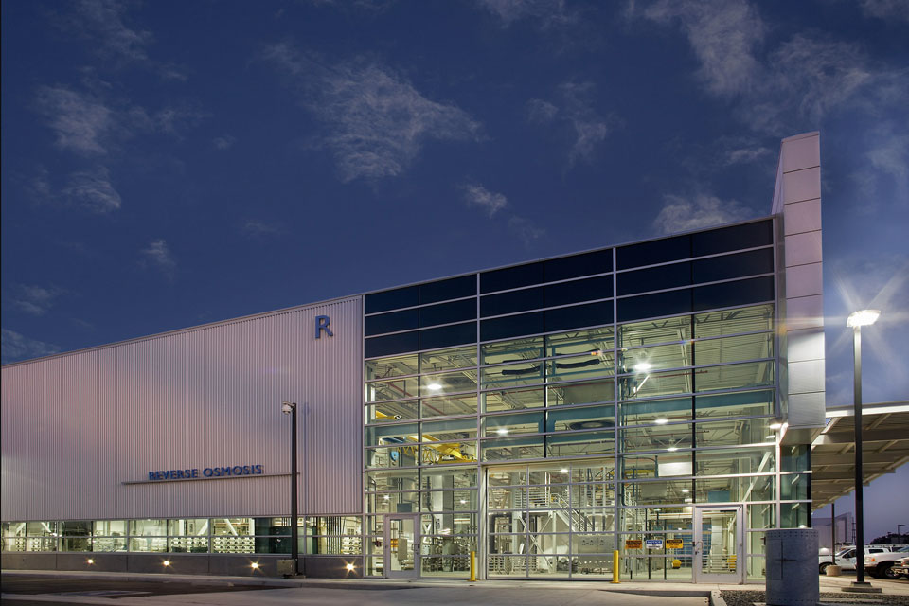
Orange County Water District Groundwater Replenishment System
GWRS Reverse Osmosis Building at Night © Larny Mack, Courtesy of CDM

Slide 50
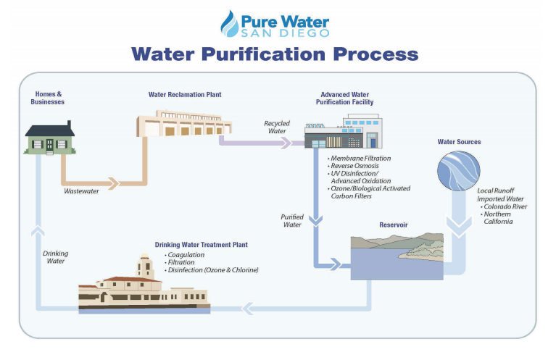
City of San Diego Pure Water Program

Slide 51
The Future: Direct Potable Reuse
CA State Water Board commissioned an Expert Panel to investigate the feasibility of DPR.
Findings due by end of 2016.

Slide 52
How Much Purified Water Can We Produce?
12 Million Gallons Per Day
4.5 Billion Gallons Per Year
Wastewater
Waste(d)water
One-third of Total Water Demand across the South Coast
One-half of Water Demand in the City of Santa Barbara

Slide 54
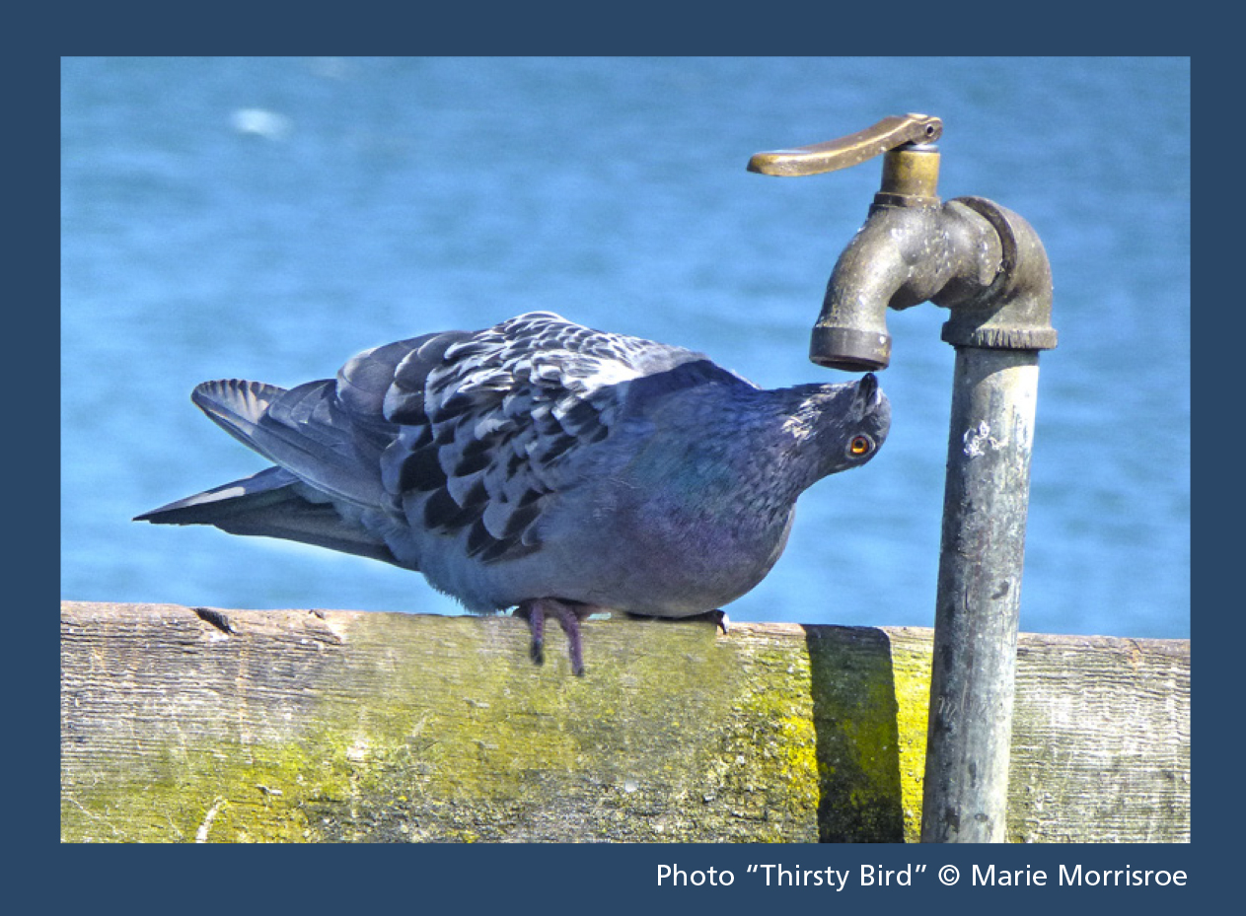
Questions?

Slide 55
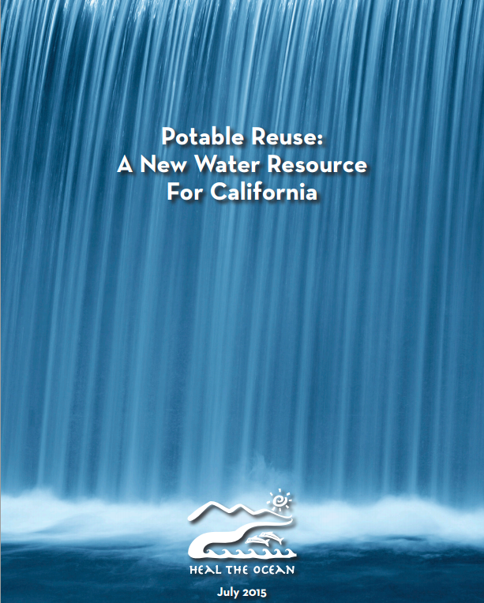
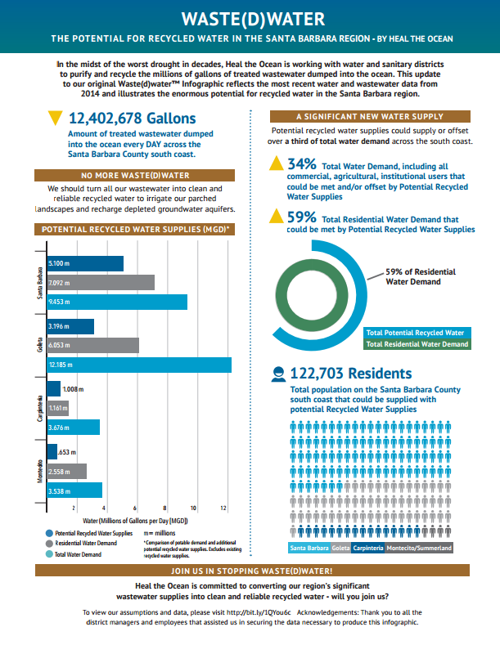
More Information
www.healtheocean.org

