Slide 1
Institutionalizing Equity through a Regional Green New Deal
Ana Rosa Rizo-Centino
David N. Pellow
Sigrid Wright
Central coast climate justice network

Slide 2
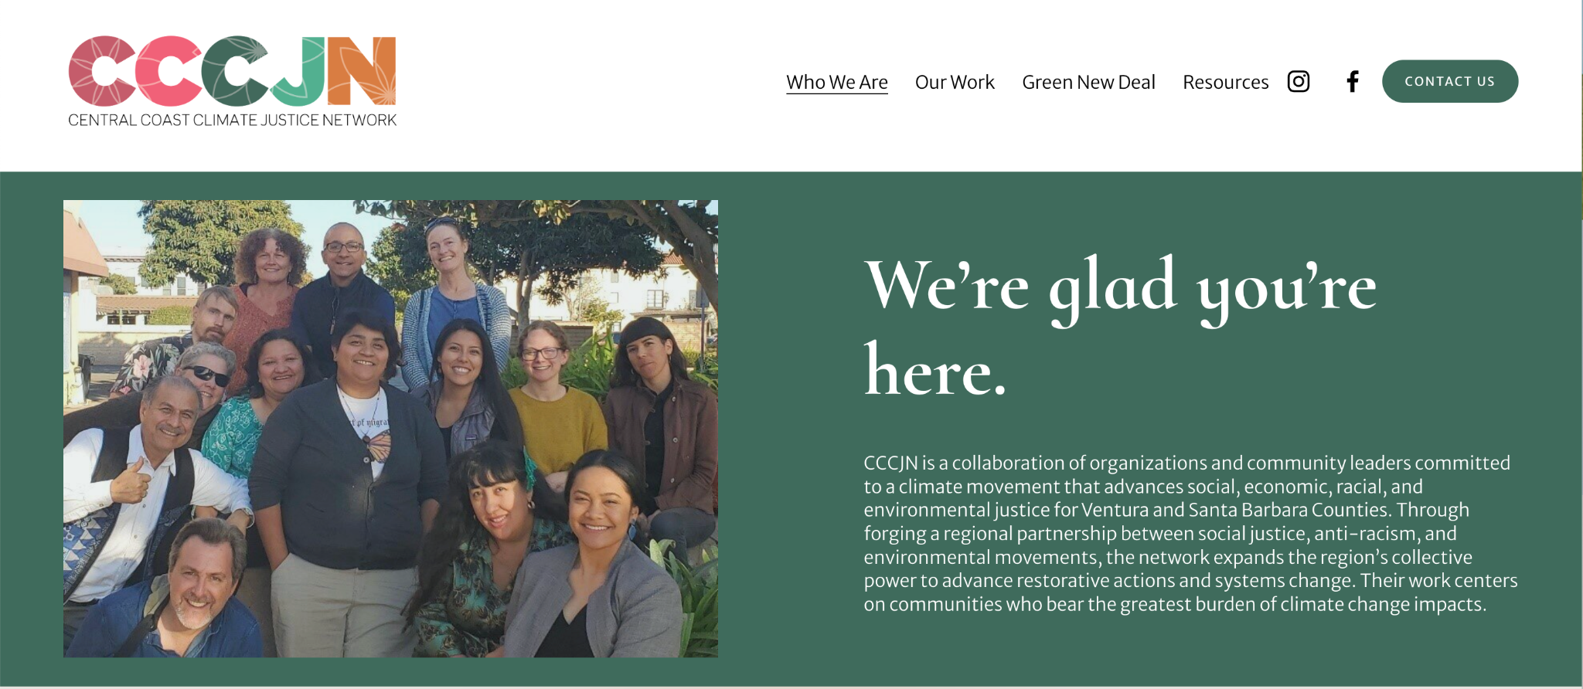

Slide 3
Our Identity
We are a network of social justice and environmental organizations and leaders committed to a climate movement that advances social, economic, and environmental justice for Ventura and Santa Barbara counties.
Our Vision
Our vision is to create a more resilient and just region in the face of climate change by leading a just transition away from fossil fuels while transforming current social, economic, and environmental systems and conditions.
Our Mission
Our mission is to forge a regional partnership between social justice and environmental movements to expand our collective power, so we can advance restorative actions and systems change centering on communities who bear the greatest burden of climate change impacts.
Who We Are

Slide 4
Center marginalized people
People who have been marginalized by deeply-rooted systems of power, oppression and inequality such as low-income people, women, immigrants and people of color, will be the most disproportionately burdened by climate change, are more sensitive to negative impacts, and have the least resources for resilience.
These frontline communities will be at the center of our decision-making and priorities, which requires dedicating meaningful resources to ensuring accessibility and opportunities to participate for those whose voices have historically been left out of conversations about environmental and climate issues. People that come from and are informed by marginalized communities will be encouraged and supported to serve in public leadership roles.
Leaders and institutions with greater access, representation, and power will commit to internal reflection and transformation to develop stronger allyship towards marginalized people and build a more inclusive and just movement.
Social Justice Lens

Slide 5
Value all forms of knowledge
The deep and broad understanding needed to break down silos in our movements and achieve transformational breakthroughs and innovative practices will require integrating many forms of knowledge and wisdom in our communities.
Indigenous knowledge, lived experiences of frontline communities, and stories of impacted people will be welcomed and valued equally alongside technical, legal , policy, and scientific knowledge to understand the needs and advance solutions for the mo
st impacted and marginalized communities.
Our analysis and action will bridge divides and connect the dots between social justice and environmental movement, “people focused” and “nature focused”, technical and experiential knowledge.
Social Justice Lens

Slide 6
Challenge unjust power
We will embrace the reality that social, economic, and environmental injustice is a direct result of intentional oppression by those who profit and benefit from putting others into positions of denied power.
Creating meaningful transformation of unjust structures, systems, and institutions requires struggle, conflict, determination, and courage to confront and hold power accountable.
Our analysis and action will recognize and address the root causes of environmental and climate injustice by resisting the forces that create systemic inequities and seeking solutions that truly transform the social, economic, and environmental conditions
Social Justice Lens

Slide 7
THE Green New Deal
Centers around addressing climate change by building a green economy that is inclusive of all people, through a process that offers a fair and just transition.
Includes a series of social programs that ensures that people have access to high quality healthcare, housing, and education
Main goal: bring U.S. greenhouse gas emissions down to net-zero and meet 100% of power demand through clean, renewable, and zero-emission energy sources by 2030.
Notes:
In 2019, Representative Alexandria Ocasio-Cortez and Senator Ed Markey introduced the Green New Deal resolution, a ground-breaking framework that boldly seeks to address the daunting challenge of global climate change by building a green economy that is inclusive of all people, through a process that offers a fair and just transition for workers otherwise negatively impacted by that shift. The main goal of the Green New Deal is to bring U.S. greenhouse gas emissions down to net zero and meet 100% of power demand through clean, renewable, and zero-emission energy sources by 2030. This policy framework would also include a series of social programs to ensure that people have access to high quality healthcare, housing, and education. In April of 2021, Ocasio-Cortez and Markey re-introduced the Green New Deal into the congressional record. This is a framework whose time has come.
Since the federal Green New Deal is a resolution rather than a law, it may productively be thought of as a canvas upon which communities around the country can paint their respective and unique visions of change. And they have done just that.

Slide 8
Examples of Local GNDs around U.S.
Los Angeles
Maine
New York City
New York State
San Diego
Seattle

Slide 9
Common Themes in GNDs
Reduction in GHG emissions
Investments in renewable energy
Green job creation promises (just transition)
Overhauling transit systems
Equity—environmental and climate justice

Slide 10
Unique Themes in Some GNDs: NY State (passed!)
Climate leadership and community protection act of 2019
Net zero GHG emissions by 2050 and scaling up of clean energy economy
Sets up climate justice working group to address environmental/climate injustice, to oversee implementation
40% of benefits from state’s climate programs to go to disadvantaged communities

Slide 11
Unique Themes in Some GNDs: new Mexico (passed!)
Energy Transition Act of 2019
accelerates the shut down of the western U.S.’s largest coal-fired power plants (San Juan generating station)
produce new Mexico’s energy from 100% carbon-free sources by 2045
Provides $70 million for reclamation and just transition for workers, including hundreds of Indigenous employees

Slide 12
Unique Themes in Some GNDs Maine (PASSED!)
Primary foci: workforce development, jobs, and renewable energy
mandates that a significant % of workers on energy generation facility construction projects must be union apprentices
First GND endorsed by AFL-CIO, which opposes the federal GND
Takeaway: organized labor is split on GND and must be a part of planning from the start
Notes:
(SEIU endorsed federal GND)

Slide 13
Unique Themes in Some GNDs: NYC (PROPOSED)
Cut beef purchases by 50%, phase out purchase of processed meat
Bans inefficient glass-walled blgs, requires large bldgs (25K sq ft+) to cut emissions via an a building mandates law--a global first
Universal healthcare for all New Yorkers regardless of ability to pay or immigration status
$20 billion in resilience planning to prepare for increased heat, coastal storms, sea-level rise, and other climate threats

Slide 14
Unique Themes in Some GNDs: California (proposed)
*Aimed at “all residents” of the State of California, regardless of wealth, income, or citizenship
*Includes reconciliation and justice for communities most severely impacted by environmental racism “from the birth of this nation to the present”
*Job training for those seeking to transition to new, clean economy jobs
*State goal of reaching carbon neutrality by 2045
*Addresses CA-specific combo of climate disruptions: floods, droughts, fires, sea-level rise AND inequalities
Notes:
In the CA State Legislature as of January 2020

Slide 15
Unique Themes in Some GNDs: Eco-Vista GND, Isla Vista (in progress)
*Housing coops, homeless/houseless plan, expanding community gardening on each block/street, expanding health care (including mental health services), ridesharing, renewable energy plan for IV and UCSB.
*Local currency (Vista Pay)
*Massive waste reduction and waste diversion
*Reduce police while increasing security and safety
*Funding Council to support much of the above
Notes:
Require UCSB to install solar panels on all school owned buildings and transition to 100% renewable energy over 10 years Solar panels on the houses and university buildings.
Wind turbines on the cliffs and in ocean where there are higher wind speeds
Tidal power, can place under wind turbines in ocean
Make sure to put tidal power in areas that won't impact wildlife
Cut ties with oil companies

Slide 16
Notes:
A number of additional far reaching frameworks have emerged in response to the Green New Deal in order to push our thinking and action even further in the direction of dramatic social change. For example, a movement of Indigenous community leaders called the Red Nation has proposed The Red Deal as a call for action beyond the scope of the US colonial state. It is a program for Indigenous liberation, life, and land—an affirmation that colonialism and capitalism must be overturned for this planet to be habitable for human and other-than-human relatives to live dignified lives. For example, the Red Deal advocates for the divestment from policing, prisons, and military institutions to achieve an end to the occupation of Indigenous lands by those inherently violent institutions. The Red Deal advocates for free health care (including mental health services) for everyone, as a step toward healing our bodies. And the Red Deal embraces the enforcement of Indigenous treaty rights, the protection of Native peoples’ sacred sites, an end to capitalism, and support for multi-species caretaking, all as a means toward healing our planet. What reasonable person could argue with that? ☺
So the next time someone asks you on the street, “Hey! Can you think of any ideas for promoting deep and dramatic change to usher in a new and substantially more equitable and just environmental and climate reality?” you can tell them all about the many Green New Deals, the Red Deal, and the Red Black & Green New Deal, and you can get fired up about supporting these plans and creating a plan for your own community as well.

Slide 17
THE RED DEAL
End the Occupation--divest from the following police and military institutions:
Defund Police/La Migra/Child Protective Services
End bordertown violence
Abolish incarceration (prisons, juvenile detention facilities, jails, border security)
End the US Military occupation everywhere
Abolish imperial borders
Notes:
The Red Deal is not a counter program of the [Green New Deal]. It’s a call for action beyond the scope of the US colonial state. It’s a program for Indigenous liberation, life, and land—an affirmation that colonialism and capitalism must be overturned for this planet to be habitable for human and other-than-human relatives to live dignified lives.
End the Occupation: divest from the following police and military institutions

Slide 18
THE RED DEAL
Heal Our Bodies--reinvest in the following:
Mental health services
Healthy, Indigenous, and abundant food for everyone
Clean water & air
Sexual and domestic violence services
End MMIWG2S
Reproductive justice
Notes:
Heal Our Bodies: reinvest in the following institutions and services
Two spirit is a pan-Indigenous term used in North America to refer to Indigenous folks who are a third gender category, gender nonconforming.

Slide 19
THE RED DEAL
Heal Our Planet--create jobs by reinvesting in the following:
Clean, sustainable energy
Traditional & sustainable agriculture
Land, water, air, & animal restoration (above and below ground)
Protect sacred sites
Free the earth from capitalism
Multi-species caretaking
Enforce treaty rights and other agreements
Notes:
Heal Our Planet: create jobs by reinvesting in the following.
So as you can see, this Red Deal Plan is quite comprehensive. Here’s another important point: Indigenous peoples are 5% of the world’s population but protect 80% of the world’s biodiversity and manage/own 35% of the world’s intact forests. THEREFORE, Defending Indigenous communities and territories and sovereignty is one of the best ways to defend the climate and global ecosystems.

Slide 20
THE RED DEAL
Citizenship & equal rights for everyone
Free & sustainable housing for everyone
Free education for everyone
Free healthcare for everyone
Free and accessible public transportation for everyone
Suicide prevention
Notes:
Heal Our Bodies: reinvest in the following institutions and services

Slide 21
THE RED DEAL
Defending Indigenous communities and territories and sovereignty is one of the best ways to defend the climate and global ecosystems
Indigenous peoples are 5% of the world’s population but protect 80% of the world’s biodiversity and manage 35% of the world’s intact forests

Slide 22
Notes:
The Red, Black & Green New Deal (RBGND) is a proposal and project of the Movement for Black Lives that is focused on protecting and strengthening six key pillars that advocates hope will create a sustainable future: democracy, economy, labor, land, energy and water. The main goal is to address the climate crisis by investing in Black communities while repairing past harms.
So the next time someone asks you on the street, “Hey! Can you think of any ideas for promoting deep and dramatic change to usher in a new and substantially more equitable and just environmental and climate reality?” you can tell them all about the many Green New Deals, the Red Deal, and the Red Black & Green New Deal, and you can get fired up about supporting these plans and creating a plan for your own community as well.

Slide 23
Green New Deal House Meetings!
How do We work with our networks & community to ensure a Just Transition through the GND?

Slide 24
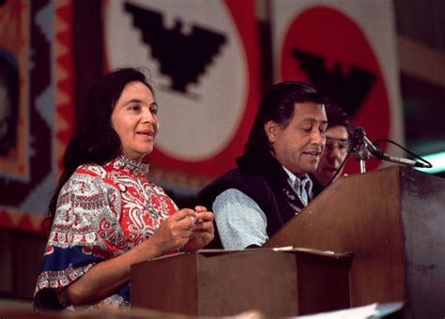
History of House Meetings
Strategy first used by the NFWA (National Farm Workers Association), co-founded by César Chavez and Dolores Huerta
UFW Website describes them as “The basic organizational building block of the farmworker movement”
Chavez and Huerta traveled around the central valleys of CA, going from town to town to meet with farmworkers in their homes and learn about their struggles
Fred Ross Sr mentored them in the house meeting strategy
“ Sometimes 2 or 3 would come, sometimes none. Sometimes even the family that called the house meeting would not be there.”

Slide 25
Why House Meetings?
Perfect example of grassroots organizing!!
Collective intelligence to inform decision-making.
Bringing demands from the “roots” (people) to the “branches” (government)
Creating an inclusive, comfortable space
Not everyone feels safe enough to come to a government building to give their input on policy decisions
Translation & Childcare is usually not provided in places of governance
House meetings provide a familiar setting, as well as personal connection, for participants to feel comfortable enough to share their ideas
These are all crucial in achieving intelligence through diversity!!
What are other benefits of house meetings? Or any other ways to make them more inclusive?
Notes:
House meetings are a perfect example of grassroots organizing: we go to our communities to discuss the needs of the people and bring these demands to our decision makers.

Slide 26
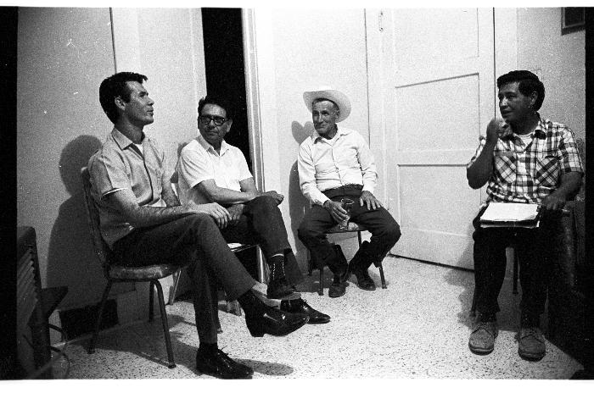
Good Questions to Ask During House Meetings
Who has heard about the Green New Deal and/or the Red Deal?
How does everyone feel about these ideas (within the Green New Deal or Red Deal)?
Is there anything that has not been thought of already that should be included in developing our People’s Red Deal/Green New Deal for the Central Coast?
Can you think of other good questions for conversation starters on a Central Coast Green New Deal?

Slide 27
Roles in Organizing a House Meeting
Outreach
Reach out to a small group (5-10) of friends, family, and co-workers.
Facilitation
Choose an accessible date, time, and location with that small group.
Until COVID19 is over, we should host online conversations using free tools like google hangouts or zoom
Share background info! Never assume that everyone automatically knows terms like “Green New Deal”
Listen and learn!
Take notes!
Post-house meeting survey
After you’ve hosted a house meeting, reach out to your friends, family, neighbors and/or co-workers to see if they are interested in hosting one of their own! (Or host another if there’s unfinished conversation!)
Notes:
Outreach is easy: all you have to do is reach out to a small group (5-10) of friends, family, and co-workers.
Big turnout pushes are not necessary for house meetings; only 5-12 people needed for successful outcomes.
If you are facilitating, you should choose an accessible date, time, and location with that small group. An accessible time, for example, would be 6/7PM - after the working day.
Until COVID19 is over, we should host online conversations using free tools like google hangouts or zoom. During the meeting,
make sure to share background info: If this is the first time people have heard the terms ‘Green New Deal’ or ‘Just Transition’, make sure to explain what all this means! Never assume that everyone automatically knows.
This is an opportunity to find out what our communities want to see in a regional Green New Deal, so listen and learn!
Also make sure to take notes: Either take notes yourself or choose someone to take notes. Be sure to capture the main ideas, questions, concerns, and goals (but don’t worry about detailed conversations).
Once the house meeting is over, while the conversation is still fresh in your mind, fill out the post-house meeting survey (or have the notetaker fill it out).
After you’ve hosted a house meeting, reach out to your friends, family, neighbors and/or co-workers to see if they are interested in hosting one of their own, and ask if people are down to come to another one if you feel like you all still have more to discuss!
Link toolkit in the chat: https://docs.google.com/document/d/11QOvRE_4jdKs80JRNb4ROIfzYYB0YqAqXMwrIPzub4E/mobilebasic#cmnt_ref2 (all of the info on slide + more resources included)

Slide 28
What’s in Our Green New Deal?
Infrastructure and Economy: Transportation, Energy, Housing, and a Just Transition
Social Justice: Policing, Indigenous Justice, and Racial Equity
Democracy: Political Process and Mobilizing to Enact Our Green New Deal
https://www.cccjn.org/gnd-report
Notes:
We grouped the ideas and statements from the house meetings and surveys into 3 broad areas in order to simplify and distill the information into a format and size that is useful and actionable. Each of these solution areas follow directly from problem statements. So for example, when people talked about investing in public transportation as a solution, this was in direct response to a problem statement that centered on the need for greater public transit.

Slide 29
Infrastructure and Economy: Transportation, Energy, Housing, Just Transition
Increase affordable housing for all
Embrace rent and mortgage forgiveness
Expand bus and train lines for regional connectivity, more dedicated bike paths
Support telecommuting
Expand green jobs, work with labor unions
project labor agreements and local hiring
Align disaster planning with job creation
Restore kelp beds, coastal lands, areas affected by fires, build climate resilient infrastructure
Notes:
We had the great pleasure of hosting two house meetings with the International Brotherhood of Electrical Workers Local 413 -- whenever we talk about the solutions to our planetary crisis being solved in part by electrification, energy efficiency, solar panels and wind, and electric vehicles, we are implicitly talking about these workers. It is noteworthy that labor (International Brotherhood of Electrical Workers -IBEW) participants were also vocal supporters of ecological vitality and connectedness, local change, and values of taking responsibility and coming together across political divides to enact change.

Slide 30
Social Justice: Policing, Indigenous Justice, and Racial Equity
Intersecting crises require intersectional solutions
Reparations to chumash communities, land trusts, Inaugurating/strengthening chumash land and water rights
Decouple property taxes from school funding
Expand health, mental health, and wellness services
Make SB a sanctuary county for undocumented persons
Reduce sheriff’s budget and county jail population, end cash bail*
Expunge criminal records of formerly incarcerated persons, create pathways to employment and entrepreneurialism in key sectors like renewable energy and perhaps cannabis
Notes:
If there is anything we have learned during this era of intersecting crises--such as racist police violence, skyrocketing social inequality, continued attacks on Indigenous peoples and their lands, and global climate disruption--it is that there can be no climate justice without racial and social justice; that we will only solve our climate crisis if we simultaneously are addressing our crises of racial and social injustice in this nation
WE ENDED CASH BAIL THIS YEAR IN CA—SUCCESS!

Slide 31
Democracy: Political Process and Mobilizing to Enact Our Green New Deal
Strong democracy needed for healthy ecosystems and climate
Change/improve the political process, enable greater community involvement in decision-making
Expand town halls, house meetings in multiple languages
Establish a regional environmental justice commission
Improve county elections process
expand free access to public meeting spaces for non-profits
https://www.cccjn.org/gnd-report
Notes:
Research on the relationship between democracy and environmental sustainability reveals that those communities, states, and nations with strong forms of political participation and respect for the rights of marginalized communities tend to be more protective of their environments and climate. This is why an organization like Greenpeace has a Democracy campaign--because we are only going to have a healthy environment if people are empowered to make decisions to protect our environment.
Re: “true primary elections” (in which candidates running for office are given the opportunity to participate in competitive contests against other candidates in the same political party.
We need system change. We need change that requires public spending at a level we have only seen in war time or during the original New Deal.
I want to note that last week Rachel Couch emailed us about the Governor’s just released $100 billion dollar budget proposal which includes climate investments and a just transition. Rachel said, “If it passes, boundless funding opportunities await those that are prepared.” Sierra Club leader Katie Davis also noted that there is also a lot of potential funding through Biden’s proposed American Jobs Plan. So we have an opportunity and a challenge

Slide 32
Exciting Developments Over the Last Year!
State and Federal Investments
Solar and energy efficiency support for low-income homes, schools, non-profits
Resilience Centers
CA Ocean Protection Council funding for Tribal communities and coastline protection
CA legislative and Executive Action
Governor’s Executive Order on Racial Equity
SB 1137 (Set backs bill)
AB 2183 (farmworkers’ right to unionize)
CA Extreme Heat Action Plan
SB 907
Local Progress
New farmers market near Lompoc
FRESA Network action on farmers market new Guadalupe
UCSB American Indian and Indigenous Studies Department approval

Slide 33
CALL TO ACTION!
SB County - join Labor Policy Councils and Resilience Policy Councils
Ventura County - Open invitations to the house meetings
Use the GND tool kit from our website to develop your own GND wherever you live
Incorporate pieces of the GND into your org’s own policy platform

Slide 34
www.CCCJN.org
facebook.com/CentralCoastCJN

Slide 35
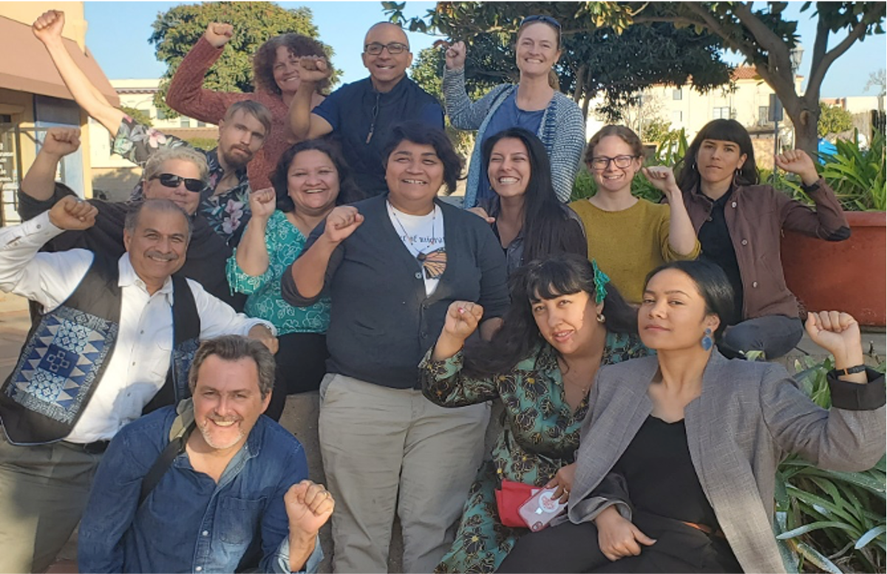
Thank you!

